Slide 1

Healthy Relationships
Date:
Presented by:

Slide 2

Today’s Agenda
Identify what healthy and unhealthy relationships look like.
Discuss personal values and beliefs about how to behave in relationships.
One of:
Practise communication (talking and listening).
Discuss how to cope with break ups.
Notes:
Choose one of “Practise communication (talking and listening)” (Activity 2, Option 1) or “Discuss how to cope with break ups” (Activity 2, Option 2). Delete the other one.

Slide 3
Group Agreement
All questions are ok, at any time.
If someone tells a personal story inside this room, it stays in this room.
Be respectful – we all have our personal values and beliefs. No putting anyone down.
It’s ok to pass.
Have fun learning!
When you see this symbol, we want you to try to answer the question!
Notes:
Write the group agreement on a whiteboard/ chart paper and hang up in the room. If anyone doesn’t follow this agreement, you can say “I want to remind everyone about the group agreement we all agreed to at the beginning of the class”

Slide 4
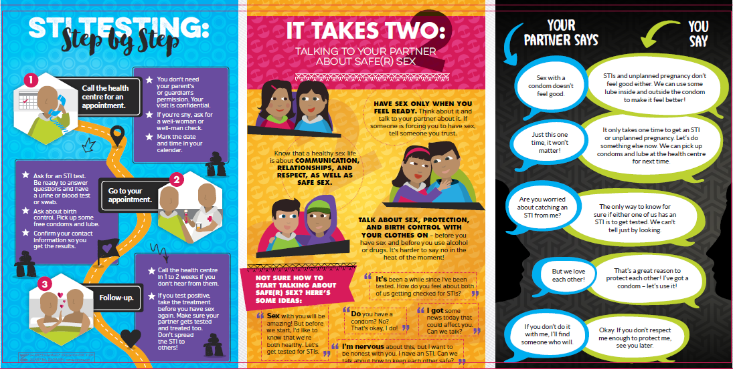
What does a healthy relationship look like?

Slide 5
What does a healthy relationship look like?
respect
communication
Enjoyment/ pleasure
trust
safety
caring

Slide 6
Activity: Healthy Relationships Scenarios
I will read a scenario and give you four choices about how to respond.
Choose one option and move to the piece of paper that indicates your choice.
There are no right or wrong answers.

Slide 7
Scenario 1
I cheated on my boyfriend because the relationship had become so predictable and I needed some excitement. He never found out and I’m not sure if I should tell him.”
Come clean and tell your boyfriend the truth.
Tell him you’re bored and try to improve your relationship.
Do nothing, what he doesn’t know can’t hurt him.
Break up.

Slide 8
Scenario 2
“My best friend has started dating this much older guy, she’s 13 and he’s 21. She says she likes him because he’s more mature than the boys our age, and he buys her stuff. He’s been asking her to have sex with him. I have a really bad feeling about this guy. Should I tell her what I think?”
It’s none of your business, so stay out of it.
You should tell her your concerns about him being so much older than her because she is your best friend.
What this guy is doing is illegal! You should tell her parents.
Visit the guy and ask him what he wants with your friend.
Notes:
Look at the “Sexual Consent: Ask, Listen, Respect” pamphlet for information about age of consent.

Slide 9
Scenario 3
“I’ve cheated on my girlfriend a few times, but they were mistakes. She kind of knows about them but she never brings it up, so I guess it doesn’t bother her. Lately I’ve been wondering if I should tell her what I’ve done.”
Honesty is the best policy. You should tell her, even if she gets mad.
Maybe she doesn’t want to know. She could be cheating too.
Don’t tell her, but don’t ever do it again.
You’re obviously not happy in the relationship. Break up with her.

Slide 10
Scenario 4
“My friend has been having sex with his girlfriend, and I know they aren’t using birth control. She’s afraid to go on the pill because she doesn’t want to get fat and he doesn’t like condoms because they don’t feel as good. They are doing the pull-out method. I just learned in health class that the pull-out method is not very effective. Should I tell him he’s playing with fire?”
Tell him today! He should also know she can get an STD that way.
The pull-out method is better than nothing, don’t say anything.
So what if they get pregnant, it would be fun to have a baby around.
Tell him, and tell him to tell his girlfriend that they pill doesn’t make you fat. Tell him to make an appointment for both of them at the health centre.
Notes:
See the “Thinking about sex? Think about birth control!” pamphlet and www.irespectmyself.ca for myths and facts about birth control.

Slide 11
Scenario 5
“My best friend has been dating this guy and she thinks she is in love with him. He’s such a player and I saw him kissing another girl behind a shed. I’m not sure if I should tell my friend since she really likes him.
Don’t tell, it’s not your business.
Definitely tell her, she needs to know he’s playing around.
Talk to him and demand that he confess to your friend.
Try and hint to your friend with being direct about it.

Slide 12
Scenario 6
“I just started dating Martha, who is such a sweetie. Now Annie, this hottie I’ve had a crush on all year, is totally into me. I want to hook up with Annie this weekend, but I don’t want to hurt Martha.”
Hook up with Annie. You’re not that serious with Martha anyway.
Talk to Martha about ending things.
Tell Annie you’re interested, but taken.
Stay true to Martha, don’t hook up with Annie.

Slide 13
Activity 2: Listen to Hear
Choose a partner and sit together back to back.
You will each have 3 minutes to talk.
The first person to talk will tell their partner how they want to be treated in a relationship. The partner will not say anything, they will just listen.
After 3 minutes, the partners will turn around to face each other. The partner will tell the first person what they heard them say.
Repeat the exercise with the person who spoke first now listening to their partner.

Slide 14
Activity 2: Surviving Break Ups
Get into groups of 2-3 people.
In your small group, come up with a list of things you can do to feel better if you are sad or upset after a break up.
We will then come back together as a big group, and each small group will read out their suggestions.

Slide 15
Reminder
You may need support to leave an unhealthy relationship.
If you are in immediate danger or thinking about harming yourself or others, call the RCMP Emergency Line.

Slide 16
Any Questions?

Slide 17



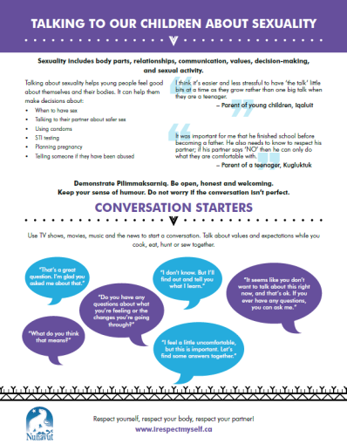


Reminder: Other Sexual Health Resources Available!
Birth Control/ Family Planning
Safer Sex
Talking to Children about Sexuality
Sexual Consent
Puberty – Change is Normal
Gender and Sexual Diversity
Notes:
If you need more, call or email me!

Slide 18

Where can I get more information?
From the Health Centre
  Community Health Representative
  Community Health Nurse or Doctor
From a trusted adult
From websites you can trust
  www.irespectmyself.ca
  www.sexandu.ca
  www.kidshelpphone.ca

