Slide 1
Family Planning – Information for Educators
January 2017
Please contact sexualhealth@gov.nu.ca if you need support to teach this topic.

Slide 2
Nunavut-Specific Resources for Teaching Family Planning
Available at: www.irespectmyself.ca, from local CHR, or by contacting sexualhealth@gov.nu.ca

Slide 3
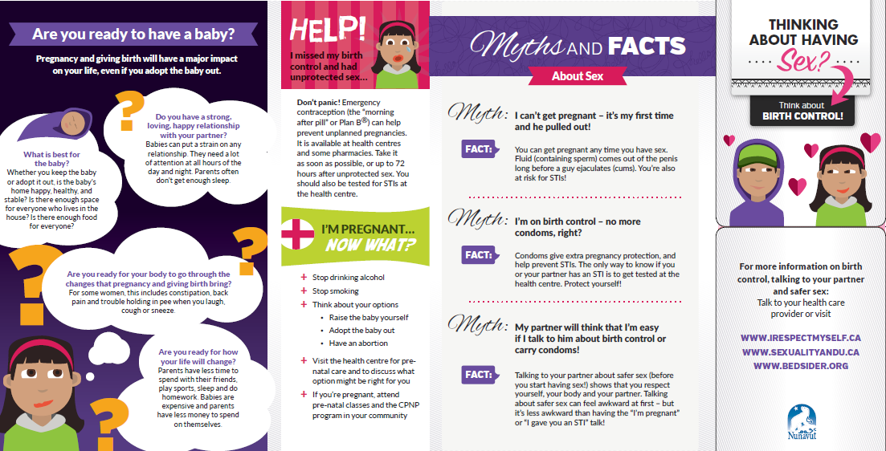
Thinking about Sex? Think about birth control! pamphlet

Slide 5
Where to use this resource
Presentations to youth (school, youth groups, etc)
Presentations to CPNP groups
Leave a pile of these anywhere you dispense condoms
As a take-home resource from well-woman, prenatal, or well-man checks
As a give away or prize at health fairs or store booths

Slide 6
Key Messages
There are lots of options for family planning in Nunavut. Choose one that works well with your lifestyle.
Having a baby will change your life – even if you adopt the baby out. Think about whether you’re ready for those changes.
Condoms are the only form of birth control that protect against pregnancy AND sexually transmitted infections (STIs).
Family planning is the responsibility of both partners.

Slide 7
Options for Family Planning
There are LOTS of options for family planning/ birth control in Nunavut – we listed 4 of the MOST common in the birth control resource.
Other options are:
Nuvaring
The Patch
Female/ Internal condoms
Most types are free for Nunavut Inuit; often covered under health insurance for non-Inuit

Slide 8
IUD (Intrauterine Device)
Key message: REALLY effective, and can last up to 5 years!
☺ | 😐 | ☹
VERY effective. | Might experience increased blood flow or cramping for a short time. | Does not protect against STIs.
Once it’s in, it can last for 5 years, and you never have to think about it. | Your period could get a bit heavier, or could go away completely .
You can remove it any time, and get pregnant right away. | Has to be put in by a qualified doctor, nurse practitioner, midwife, or nurse – check at your health centre to learn more.
You and your partner can’t feel that it’s there.
Safe for new moms.
Notes:
IUD is great because it lasts for 5 years and you don’t have to think about it. Good for young women, even if they haven’t had a baby.
If you talk about IUD first, girls are more likely to choose it.
☺ - advantages
😐 - information, not good or bad
☹ - disadvantages

Slide 9
Depo-Provera/ The Shot/ The Needle
Key Message: Make sure you get the shot on time! (every 12-13 weeks)
☺ | 😐 | ☹
No one can tell you’re using it. | VERY effective – as long as you get the shot on time! (every 12-13 weeks) | Does not protect against STIs.
Easy to get! Available from nurses at your local health centre. | Most common side effects are irregular bleeding and increased appetite
Can improve the symptoms of PMS, menstrual cramps, and endometriosis. Can decrease risk of anemia and endometrial cancer. | Getting pregnant once you stop – some women can get pregnant immediately, other women might take longer (about nine months)
Usually decreases your period, or might stop it completely.
Safe for new moms.
Notes:
☺ - advantages
😐 - information, not good or bad
☹ - disadvantages

Slide 10
Birth Control Pill
Key message: You MUST take it at the same time. EVERY DAY!
☺ | 😐 | ☹
All health centres have birth control pills! | Effective when taken perfectly – but it’s hard to be perfect! (have to take it at the same time, every day) | Doesn’t protect against STIs.
Protects against endometrial and ovarian cancer, anemia, ovarian cysts, and pelvic inflammatory disease. | Common side effects are irregular bleeding, sore breasts, nausea. These should go away after a while. | Wait 3-6 weeks after giving birth for most types.
May make periods lighter and shorter – or you can skip periods completely!
Notes:
IUD, Depo, and the pill are all really effective methods of birth control – the difference is in how easy it is to make a mistake. It’s easy to make a mistake with the pill, a bit harder to make a mistake with Depo, and really hard to make a mistake with IUD.
☺ - advantages
😐 - information, not good or bad
☹ - disadvantages

Slide 11
External (Male) and Internal (Female) Condoms
Key Message: Condoms are the only birth control that also protect against STIs
☺ | 😐 | ☹
Condoms are the only birth control that protect against STIs (if used correctly) | Some people think condoms decrease sensation or interfere with “the mood”. Try putting a bit of lube in and on the condom, and practice putting them on so it’s easier! | Effective if used perfectly – but almost no one uses it perfectly!
No side effects! (Latex-free condoms are available if you or your partner is allergic to latex)
External condoms are available in every community, free at health centres and some other community locations. Internal condoms are available free in some communities.
Notes:
☺ - advantages
😐 - information, not good or bad
☹ - disadvantages

Slide 12
Nuvaring
Key Message: It’s a small, flexible ring worn inside the vagina for three weeks at a time. Use a new ring every month!
☺ | 😐 | ☹
You only need to remember it twice per month (to put it in and take it out) | It’s placed inside the vagina, so it helps if you’re comfortable with your body (it’s similar to using a tampon or menstrual cup) | Does not protect against STIs
Protects against endometrial and ovarian cancer, anemia, ovarian cysts, and pelvic inflammatory disease. | Possible side effects are: bleeding between periods, tender breasts, or nausea and vomiting. These should go away after a while.
May make periods lighter and shorter – or you can skip them completely!
Notes:
☺ - advantages
😐 - information, not good or bad
☹ - disadvantages

Slide 13
The Patch
Key message: place it on the bum, stomach, upper outer arm, or shoulder – but never on the breast!
☺ | 😐 | ☹
May cause more regular, shorter, and lighter periods. | Possible side effects are: bleeding between periods, tender breasts, nausea and vomiting, skin irritation from the patch. Most of these should go away after a while. | Does not protect against STIs.
Only have to change it once per week.
You can get pregnant right after stopping the patch.
Protects against endometrial and ovarian cancer, anemia, ovarian cysts, and pelvic inflammatory disease.
Notes:
☺ - advantages
😐 - information, not good or bad
☹ - disadvantages

Slide 14
A note about side-effects
Common side effects to hormonal birth control are:
bleeding between periods
tender breasts
nausea and vomiting
A change in sex drive
Most side-effects should go away after a while.
If someone continues to have uncomfortable side effects from their birth control after three months, encourage them to see a nurse or doctor to switch methods (and use a condom to stay protected!).

Slide 15
Dual Protection and Abstinence
Dual protection is when you use a condom at the same time as any other form of birth control. Extra protection against pregnancy AND STI protection
Most teenagers in Nunavut are NOT having sex!

Slide 16
Are you ready to have a baby?
Keep it positive!
Ask questions like:
What are the good things about having a baby when you’re young? What are the good things about having a baby when you’re older?
Talk about Inuit values
Inuit values teach us that it is best to wait to have babies until we can provide for them.
Inuit values remind us that people have babies when they are ready to be teachers.

Slide 17
Emergency Birth Control/ Plan B
Emergency contraception is available at every health centre in Nunavut
Free for Nunavut Inuit; often covered under health insurance for non-Inuit
It is more effective if it is used soon after unprotected sex (less than 3 days, but up until 5 days)

Slide 18
I’m pregnant…now what?
There will be youth who get pregnant – it’s important that they know what to do!
Encourage them to book a pre-natal visit at the health centre.
Encourage them to stop drinking alcohol and stop smoking.
If they can’t quit, then reduce the amount they are drinking/ smoking.
If they need help to quit/ reduce, they can get help at the health centre.
Keeping the baby, adoption, and abortion are options in all Nunavut communities.

Slide 19
Adoption
Adoption means that the biological mother will continue the pregnancy and then give up parental rights to someone else after the baby is born
Women can change their mind about adoption up until the point that the adoption becomes legal

Slide 20
Abortion
Abortion means ending the pregnancy with medication or surgery.
In Nunavut, abortions are available in Iqaluit up to 13 weeks. Travel to Iqaluit is covered.
Abortion is available later than this in other parts of Canada.
Abortion does not affect the ability to have other children in the future
Abortion is legal in Canada, and it is always the woman’s decision whether or not to have an abortion

Slide 21
Myths and Facts
Myths and facts are a great way to engage the group.
You can get pregnant any time you have sex.
You can get pregnant even if your partner pulls out (and you’re at risk for STIs!)
Most types of family planning don’t protect against STIs. Only condoms protect against pregnancy AND STIs.
It’s easier to talk about protection than it is to have a baby or get treated for an STI.

Slide 22
Choices
Available in all schools in Nunavut: graphic novel, lesson plans, and DVD
Approved by Dept of Education for Grade 7-9 Aulajaaqtut
Themes: sexual health, decision making, peer pressure, healthy relationships, communication, accessing health care

Slide 23
Extra note for educators regarding age of consent for STI testing/ treatment and birth control:
Anyone, of any age, can come to the health centre for STI testing/ treatment and birth control.
If the person is young, the nurse may ask a few extra questions to be sure that the person is not being sexually abused and to be sure that the person understands the benefits and risks of treatment.

Slide 24
Our role as sexuality educators
Build our participants’
Knowledge
Skills
Confidence
How can we do this?

Slide 25
Best Ways to Teach
Find out what they already know
Make them feel good about themselves – recognize success!
Make it relevant to their life
Focus on good things – not just fear
Humour – get the giggles out
Drama/ Role Play
Telling stories
Yell out words to get comfortable saying them
Arts and crafts
Songs
Radio and TV script writing
Videos
Activities and games
Debates
Expert groups – have them teach themselves!
Storytelling
Hands-on
Pictures
Guest speakers
Field trips
Question box
Ask questions to check participant’s understanding

Slide 26
Activities for Teaching about Family Planning
Think-Pair-Share
Gallery Walk
Role Play
True/False
Expert Groups
BINGO
Storytelling – stories, poems, songs
Condom balloons
Debates
Guest speakers
Field trips to the health centre
Games for Adolescent Reproductive Health - http://www.iwtc.org/ideas/10_games.pdf

Slide 27
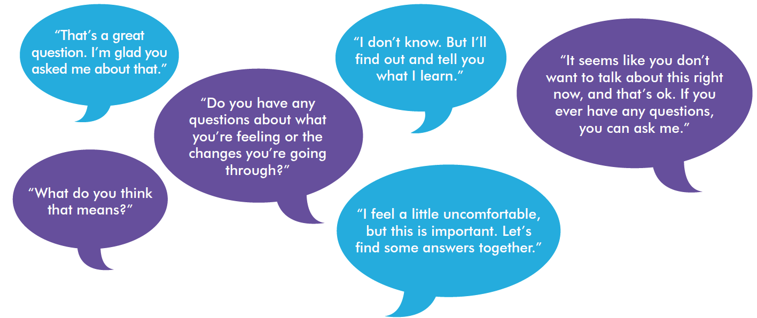
Tips for educators teaching sexual health
Be honest, open, and welcoming
Keep your sense of humour
Don’t worry if the conversation isn’t perfect
Use TV shows, music, movies, the news, and real life to start a conversation.

Slide 28
“People won’t remember what you said or what you did. They will remember how you made them feel.”

Slide 29
Consider…
Asking a respected Elder to come in and speak about the topic to share traditional knowledge and values.
Meet with the Elder in advance to discuss the topic and ensure appropriate, inclusive, and respectful sharing of knowledge. Consider whether there is any potential for hurt or harm in the information being shared.
After the Elder leaves, have a discussion with your group about similarities and differences between traditional and modern knowledge. Be prepared to answer questions with objective, factual, and up-to-date information.

Slide 30
Please review “Teaching Sexual Health – Background Information for Educators” at www.irespectmyself.ca.
Please check out the “Pregnancy and Family Planning” Classroom Presentation and Lesson Plan at www.irespectmyself.ca.
Want more information about family planning?
http://www.irespectmyself.ca/en/having-sex/protect-yourself/birth-control
https://www.bedsider.org/methods
http://www.sexandu.ca/contraception/

