Slide 1

ᐅᖃᖃᑎᖃᖕᓂᖅ ᓄᑕᖅᑲᑦᑎᓐᓂᑦ ᓄᓕᐅᕐᓂᓕᕆᓂᖕᓂᑦ
ᐅᓪᓗᖅ:
ᐅᖃᕆᐊᖅᑐᖅᓯᒪᔪᖅ:

Slide 2
ᐅᓪᓗᒥ ᑲᑎᒪᔾᔪᑎᒃᓴᑦ
ᐃᓕᑦᑎᓗᑕ ᐅᖃᐅᓯᖃᓕᕌᖓᑕ "ᓄᓕᐊᖕᓂᓕᕆᓂᖕᒥᑦ" "ᐊᐃᑉᐸᕇᑦᑎᐊᖕᓂᓕᕆᓂᖕᒥᓪᓗ".
ᐃᓕᑦᑎᓗᑕ ᖃᓄᖅ ᓄᑕᖅᑲᑦᑎᓐᓄᑦ ᐅᖃᓪᓚᖃᑦᑕᕆᐊᖃᖕᒪᖔᑦᑕ ᓄᓕᐊᖕᓂᓕᕆᓂᖕᓂᑦ ᐊᔾᔨᒌᙱᑦᑑᑎᓄᑦ ᐅᑭᐅᓕᖕᓄᑦ.
ᑭᐅᓕᒻᒪᒃᓴᖕᓂᖅ ᐊᐱᖅᑯᑕᐅᓲᓂᑦ ᓄᑕᖅᑲᓄᑦ.
Notes:
2

Slide 3
ᑲᑎᙵᔪᓄᑦ ᐊᖏᕈᑎ
ᐊᐱᖅᑯᑎᓕᒫᑦ ᖃᓄᐃᙱᑦᑐᑦ, ᖃᖓᑐᐃᓐᓇᖅ.
ᑭᓇᑐᐃᓐᓇᖅ ᐅᓂᒃᑳᕈᓂ ᐃᒡᓗᕈᓯᐅᑉ ᐃᓗᐊᓂ, ᐃᓗᐊᓃᖏᓐᓇᖕᓂᐊᕐᐳᖅ.
ᐃᖅᑲᖅᑐᐃᓂᖃᙱᓪᓗᓂ − ᓇᖕᒥᓂᖅ ᐱᒻᒪᕆᐅᒋᔭᖃᕋᑦᑕ ᐅᐱᒋᔭᖃᖅᖢᑕᓗ.
ᑲᑕᒃᓴᐃᓂᖃᙱᓪᓗᓂ.
ᖁᕕᐊᓱᒡᓗᓯ ᐃᓕᓐᓂᐊᕆᑦᑎ!
ᐃᒪᐃᓕᖓᔪᒥ ᑕᑯᒍᕕᑦ, ᑭᐅᓇᓱᖁᕙᑦᑎᒋᑦ ᐊᐱᖅᑯᑕᐅᔪᒥᑦ!
Notes:
Write the group agreement on a whiteboard/ chart paper and hang up in the room. If anyone doesn’t follow this agreement, you can say “I want to remind everyone about the group agreement we all agreed to at the beginning of the class”

Slide 4

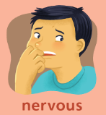
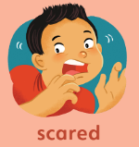
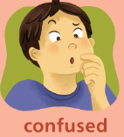

ᐃᓄᒻᒪᕆᒃᓴᐅᑏᑦ
ᑮᓇᙳᐊᓕᐅᕐᓗᑎᑦ ᓂᐱᓲᑎᒍᑦ ᐊᓕᓚᔪᒃᑯᑦ − ᖃᓄᐃᒋᖕᒪᖔᑦ ᓄᑕᖅᑲᓄᑦ ᒪᒃᑯᒃᑐᓄᓪᓗ ᐅᖃᖃᑎᖃᖕᓂᖅ ᐊᐃᑉᐸᕇᑦᑎᐊᖕᓂᓕᕆᓂᖕᒥᑦ?

Slide 5
ᐃᓄᒻᒪᕆᒃᓴᐅᑏᑦ
ᑮᓇᙳᐊᓕᐊᑦ ᐃᓕᓗᒍ (ᐱᒻᒪᕆᐅᙱᑦᑐᒥᑦ ᐱᒻᒪᕆᒻᒪᕆᖕᒧᑦ) − ᖃᓄᑎᒋ ᐱᒻᒪᕆᐅᖕᒪᖔᑦ ᐅᖃᐅᓯᖃᖕᓂᑦ ᐊᐃᑉᐸᕇᑦᑎᐊᖕᓂᓕᕆᓂᖕᒥᑦ ᓄᑕᖅᑲᓄᑦ ᒪᒃᑯᒃᑐᓄᓪᓗ?
ᐱᒻᒪᕆᐅᙱᑦᑐᖅ
ᐱᒻᒪᕆᓪᓛᓗᒃ

Slide 6
ᑭᓲᕙ ᐊᐃᑉᐸᕇᑦᑎᐊᖕᓂᓕᕆᓂᖅ/ᓄᓕᐊᕐᓂᖅ?

Slide 7
ᑭᓲᕙ ᐊᐃᑉᐸᕇᑦᑎᐊᖕᓂᓕᕆᓂᖅ/ᓄᓕᐊᕐᓂᖅ?
ᐱᓪᓚᕆᒋᔭᑦ − ᑭᓱᑦ ᐱᒻᒪᕆᐅᒋᔭᕗᑦ
ᑐᓴᐅᒪᖃᑦᑕᐅᑎᓂᖅ − ᖃᓄᖅ ᐅᖃᓪᓚᖃᑎᖃᖅᐸᖕᒪᖔᑦᑕ ᐊᓯᑦᑎᓐᓂᑦ
ᐃᓚᒌᖕᓃᑦ
ᑎᒥᒥ ᐃᒻᒥᒥᒡᓗ ᐃᓱᒪᒋᓂᖅ − ᖃᓄᖅ ᐅᕙᑦᑎᓐᓂᑦ ᐃᒃᐱᒋᒻᒪᖔᑦᑎᓐᓂᑦ
ᑎᒥᓂᒃ ᖃᐅᔨᓴᐃᓂᖅ ᑎᒥᓗ − ᑎᒥᐅ ᐃᓗᓕᖏᑦ
ᓄᓕᐊᕐᓂᓕᕆᓂᖅ
ᑎᒥᒃᑯᑦ (ᓄᓕᐊᖕᓂᖅ)
ᑭᓲᓂᖏᑦ, ᐊᕐᓇᑦ ᐊᖑᑎᓪᓗ ᐱᓕᕆᐊᖏᑦ, ᓇᓗᓇᐃᒃᑯᑕᖏᑦ
ᖃᓄᖅᑑᕈᓯᐅᕐᓂᖅ

Slide 8
ᖃᓄᐃᒻᒪᑦ ᐅᖃᓪᓚᖃᑦᑕᕆᐊᖃᓕᖅᐱᑕ ᓄᓕᐊᖕᓂᓕᕆᓂᖕᓂᑦ ᓄᑕᖅᑲᓄᑦ ᒪᒃᑯᒃᑎᓪᓗᒋᑦ?
ᓄᓕᐊᖕᓂᓕᕆᓂᖅ ᑐᓴᐅᒪᖃᑦᑕᐅᑎᓕᕆᓂᖕᒨᖓᖕᒪᑦ, ᐃᓚᒌᖕᓂᖅ, ᐃᒃᐱᖕᓂᐊᓂᖕᒧᑦ ᐃᒻᒥᒥᒡᓗ ᐃᓱᒪᒋᓂᖕᒧᑦ.
ᐅᖃᐅᓯᖃᓕᕌᖓᑦᑕ ᑐᓴᐅᒪᖃᑦᑕᐅᑎᓕᕆᓂᖕᑦ, ᐃᓚᒌᖕᓂᖕᒥᑦ, ᐃᒃᐱᖕᓂᐊᓂᖕᒥᑦ ᐃᒻᒥᒥᒡᓗ ᐃᓱᒪᒋᓂᖕᒥᓪᓗ ᒪᒃᑯᒃᑐᓂᑦ, ᓄᑕᖅᑲᑦ ᐃᓕᑦᑎᔪᓐᓇᖅᑐᑦ ᐃᓐᓇᕐᑎᑑᕈᓐᓇᕐᓯᓗᑎᒃ.

Slide 9
ᕿᑐᕐᙵᕗᑦ ᐃᓐᓇᐅᓕᕈᑎᒃ, ᐃᒪᐃᖁᒐᑦᑎᒍᑦ...
Notes:
Be Happy
Be Healthy
Be Safe
Have Good relationships
Have Children
Feel good about their bodies
Wait until they are ready to have sex

Slide 10
ᕿᑐᕐᙵᑦᑎᓐᓄᑦ ᐅᖃᓪᓚᖃᑦᑕᕈᑦᑕ ᐊᐃᑉᕋᕇᑦᑎᐊᖕᓂᓕᕆᓂᖕᒥᑦ ᐊᑑᑎᖃᕋᔭᖅᑐᖅ ᓄᑕᖅᑲᑦᑎᓐᓄᑦ ᐃᒫᒃ:
  ᐊᑦᑕᕐᓇᕐᑐᒦᑦᑕᐃᓕᓂᖅ
  ᖁᕕᐊᓱᖕᓂᖅ
  ᖃᓄᐃᙱᑦᑎᐊᕐᓂᖅ
  ᐃᓚᒌᑦᑎᐊᖕᓂᖃᕐᓗᓂ
  ᑎᒥᒥᓂᒃ ᓈᒻᒪᒍᓱᒡᓗᓂ
  ᓄᑕᖅᑭᐅᓕᕐᓗᑎᒃ ᐱᔪᓐᓴᕐᓯᒍᑎᑦ
  ᐅᑕᖅᑭᓗᑎᒃ ᓄᓕᐊᖕᓂᖕᒥᑦ
Notes:
Doesn’t make them more likely to have sex.
If they are not learning from you, they are learning from TV, movies, music, and their friends. Often, the information they get from those sources is wrong. If we want them to have the right information, we need to talk to them.

Slide 11
ᓄᑕᖅᑲᑦ ᒪᒃᑯᒃᑐᓪᓗ ᐊᔾᔨᒌᙱᑦᑑᑎᓂᒃ ᑐᓴᐅᒪᔭᕆᐊᓖᑦ ᐊᔾᔨᒌᙱᑦᑐᓂᑦ ᐅᑭᐅᖏᑦ ᒪᓕᒡᓗᒋᑦ

Slide 12
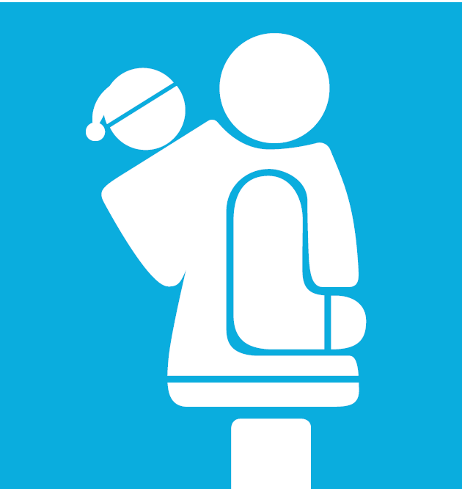
ᐅᑭᐅᓖᑦ 0-2
ᑎᒥᖏᑦᑕ ᑭᓲᓂᖏᓐᓂᑦ ᑕᐃᓯᔪᓐᓇᕐᓯᓗᓂ
  ᐅᓱᒃ, ᐅᒃᑐᒃ, ᐅᒃᐸᑎ, ᐃᕕᐊᖐᒃ
Notes:
Is this easy/ hard? Is it easier/ harder to use Inuktitut/ Innuinaqtun than English?

Slide 13
ᐅᑭᐅᓖᑦ 2-7
ᑭᒃᑯᑐᐃᓐᓇᓄᑦ ᑲᙳᓇᖅᑐᓪᓗ ᖃᓄᐃᓕᐅᖕᓂᐅᕙᒃᑐᓪᓗ.
ᑭᖃ ᐊᒃᑐᕈᓐᓇᖅᐸᖏᑦ, ᖃᖓᓗ. ᐅᖃᑦᑎᐊᖃᑦᑕᕐᓗᑎᑦ!
ᐊᑦᑕᖕᓇᙱᑦᑐᑦ ᐊᑦᑕᖕᓇᖅᑐᑎᒍᓪᓗ ᐊᒃᑐᖅᑕᐅᓂᖅ. ᐅᖃᐅᑎᓯᒪᒃᑭᑦ ᐅᖃᓛᖁᓗᒋᑦ, ᓂᙵᔾᔮᖏᓐᓂᕋᕐᓗᑎᓪᓗ, ᑕᐃᒪᐃᑎᑦᑎᖏᓐᓂᕋᕐᓗᒋᓪᓗ.
ᐃᓕᓴᕆᓗᒋᑦ ᐊᑦᑎᕐᓗᒋᓪᓗ ᐃᒃᐱᒍᓱᖕᓂᕆᔭᑦ.
ᑭᐅᓗᒋᑦ ᐊᐱᖅᑯᑎᑦ.
Notes:
Be specific.
It’s ok if mummy or daddy helps you wipe after you go to the bathroom.
It’s ok if the nurse or doctor needs to check your private parts, as long as mummy or daddy are there.
It’s ok if someone is helping you get dressed.
If someone asks you to touch their private parts, that’s not ok.

Slide 14

ᐅᑭᐅᓖᑦ 7-12
ᖃᓄᖅ ᓄᑕᕋᓛᑦ ᐱᑕᖃᓕᓲᖑᓂᖏᑦ
ᐃᓚᒌᓄ ᐱᓪᓚᕆᒋᔭᑦ ᓂᕆᐅᒋᔭᓪᓗ
ᐃᒻᒥᒥ ᐃᓱᒪᒋᔭᒥᑦ ᐱᕈᖅᓴᐃᓂᖅ
ᓄᑕᖅᑲ (ᐅᑭᐅᓖᑦ 8-9)
ᓄᓕᐊᖕᓂᒃᑯᑦ ᖁᐱᕐᕆᔾᔪᑕᐅᓲᑦ ᓇᔾᔨᔾᔭᐃᒃᑯᑏᓪᓗ (ᐅᑭᐅᓖᑦ 10-12)
Notes:
Some family values might be – I want you to be older when you have sex. I want you to be married when you have sex. I want you to finish school before you have a baby. I want you to respect your partner.
Around this age, they start to hear things from their friends. Better to hear them an adult who cares about them, to make sure the information is correct.

Slide 15
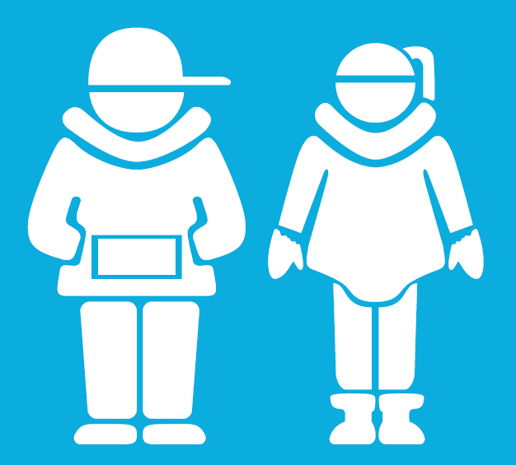
ᐅᑭᐅᓖᑦ 13-18
ᐱᒋᐊᖅᑎᑦᑎᓂᖅ ᐅᖃᖃᑎᒌᖕᓂᕐᒥᒃ
ᓇᓗᓇᐃᔭᕆᐊᒃᑲᓐᓂᕐᓯᒪᔪᑦ − ᓄᓕᐊᖕᓂᒃᑯᑦ ᖁᐱᕐᕆᔾᔪᑕᐅᓲᑦ ᓇᔾᔨᔾᔭᐃᒃᑯᑏᓪᓗ
ᐱᐅᔪᑦ ᓈᒻᒪᙱᑦᑐᓪᓗ ᐊᐃᑉᐸᕇᖕᓃᑦ
ᖃᓄᐃᓕᐅᖕᓂᖅ − ᓇᓗᓇᐃᔭᑦᑎᐊᕐᓗᒍ!
ᐃᒻᒥᒥ ᐃᓱᒪᒋᔭᒥᑦ ᐱᕈᖅᓴᐃᓂᖅ
ᐊᑦᑕᖕᓇᖅᑕᐃᓕᒪᑦᑎᑦᑎᒃᑲᓐᓂᖕᓂᖅ
ᐱᓕᒻᒪᒃᓴᐃᓗᑎᒃ, ᐃᓚᐅᓗᓂ ᑐᓴᐅᒪᖃᑦᑕᐅᑎᓂᓕᕆᓂᖅ
Notes:
“Safer sex” = if someone decides to have sex, how can they make it as safe as possible? Use condoms. Use birth control. Get tested regularly for STIs. Talk to their partner.

Slide 16
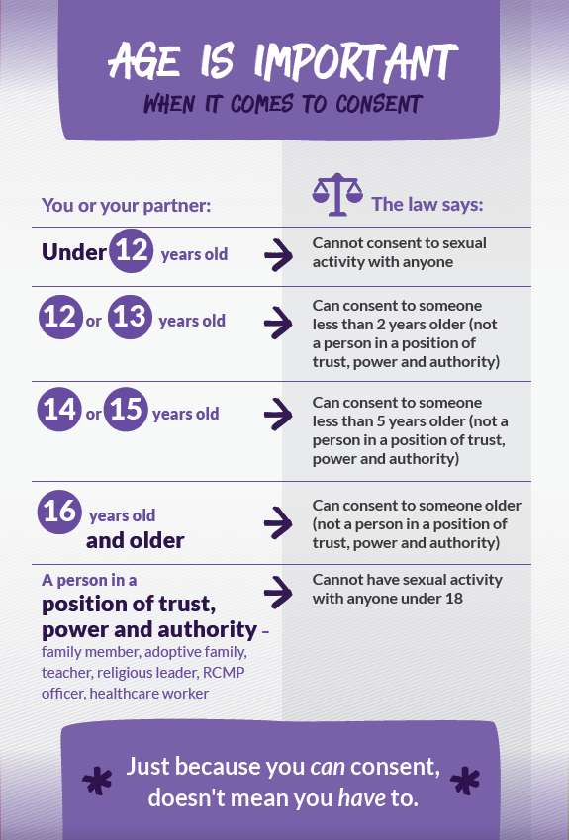
ᐅᑭᐅᕆᔭᑦ ᐊᖏᕈᓐᓇᖅᑐᑦ ᓄᓕᐊᖃᑦᑕᓕᖕᓂᖕᒧᑦ

Slide 17
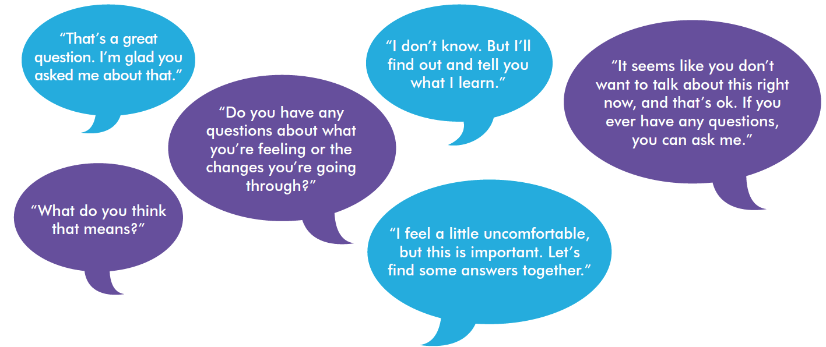
ᖃᐅᔨᒪᔭᒃᓴᑦ ᐊᖓᔪᖅᑳᓄᑦ
ᓱᓕᓗᑎᑦ, ᐅᒃᑯᐃᖓᓗᑎᑦ ᑐᙵᓇᕐᓗᑎᓪᓗ
ᒥᑖᕈᓐᓇᕐᓗᑎᑦ
ᐃᓱᒫᓗᙱᓪᓗᑎᑦ ᐅᖃᐅᓯᕆᔭᔅᓯ ᐱᐅᓪᓚᕆᙱᑉᐸᑦ
ᐊᑐᕐᐸᒡᓗᒋᑦ ᑕᓚᕖᓴᒃᑰᖅᑐᓂᑦ, ᑐᓴᖕᓈᓂᖕᓂᑦ, ᐱᕙᓪᓕᐊᔪᓂᑦ, ᐊᑐᕐᑕᐅᓪᓚᕆᒃᑐᓂᓪᓗ ᐅᖃᓪᓚᒋᐊᕈᑎᖃᖕᓂᖕᒥᑦ.
ᑐᓴᐅᒪᑎᓪᓗᒋᑦ ᐃᓚᒋᔭᖕᓄ ᐱᓪᓚᕆᒋᔭᑦ ᓂᕆᐅᒋᔭᓪᓗ.

Slide 18
ᐱᓕᕆᐊᒃᓴᖅ 1: ᐱᓱᖃᑎᒌᖕᓂᖅ ᐳᓛᕐᕕᖕᒥᑦ
ᐊᐱᖅᑯᑕᐅᒐᔪᒃᑐᑦ ᓄᑕᖅᑲᓄᑦ!
ᑲᑎᙵᐅᖅᑐᑦ ᐅᑭᐅᑎᒍᑦ ᒪᓕᒡᓗᑎᒃ ᑭᐅᖃᑦᑕᖕᓂᐊᖅᑐᑦ ᐅᑯᓄᖓ ᐊᐱᖅᑯᑎᓄᑦ:
  ᐊᐱᖅᑯᑦ 1
  ᐊᐱᖅᑯᑦ 2
  ᐊᐱᖅᑯᑦ 3
Notes:
You can do this as a large group, or in small groups – each group takes a question or two and comes up with some answers.

Slide 19
ᐱᓕᕆᐊᒃᓴᖅ 2: ᐃᓕᑦᑎᑦᑎᔾᔪᑏᑦ
ᑲᑎᙵᐅᖅᑐᑦ ᑐᓂᐅᖅᑲᖅᑕᐅᕗᑦ "ᐃᓕᑦᑎᑦᑎᔪᑎᓂᑦ" ᖃᓄᐃᓕᐅᒐᒃᓴᓂᑦ
ᑖᒃᑯᐊ ᖃᓄᐃᓕᐅᕋᖕᔭᖕᒪᖔᖏᑦ ᐊᖓᔪᖅᑲᐅᓗᑎᒃ/ᐸᖅᑭᔨᐅᓗᑎ
ᑖᒃᑯᐊ ᑲᑎᙵᐅᖅᑐᑦ ᐱᙳᐊᕐᓂᐊᕐᐸᒡᓗ ᖃᓄᐃᓕᐅᒐᒃᓴᑎᒃ ᑭᐅᔾᔪᓯᖏᓪᓗ ᑕᒪᐃᓐᓄᑦ ᑲᑎᑉᐸᑕ ᐊᓯᖏᓐᓄᑦ

Slide 20
ᐱᕈᖅᓴᐃᔪᓐᓇᖅᐳᒍᑦ ᓄᑕᖅᑲᑦᑎᓐᓂᑦ ᖁᕕᐊᓱᒡᓗᑎ, ᖃᓄᐃᙱᑦᑎᐊᕐᓗᑎᒃ, ᐊᑦᑕᖕᓇᙱᑦᑐᒦᓪᓗᑎᒡᓗ!

Slide 21
ᑐᑭᓯᒋᐊᒃᑲᓐᓂᕈᒪᒍᕕᑦ
http://www.upworthy.com/5-everyday-ways-to-teach-your-kids-about-consent
http://parents.teachingsexualhealth.ca/topics/resources.html
www.inuithealthmatters.aboutkidshealth.ca/

Slide 22
ᐊᐱᖅᑯᑎᒃᓴᑦ?
ᖁᔭᓐᓇᒦᒃ!

