Slide 1

Pregnancy, Family Planning, and Safer Sex
Date:
Presented By:

Slide 2

Today’s Agenda
Anatomy Review
How does pregnancy happen?
What does it mean to get pregnant, and what are the options?
Family planning options
Notes:
2

Slide 3
Group Agreement
All questions are ok, at any time.
If someone tells a personal story inside this room, it stays in this room.
No judgement – we all have our personal values and beliefs.
No putting anyone down.
Have fun learning!
When you see this symbol, we want you to try to answer the question!
Notes:
Write the group agreement on a whiteboard/ chart paper and hang up in the room. If anyone doesn’t follow this agreement, you can say “I want to remind everyone about the group agreement we all agreed to at the beginning of the class”

Slide 4
Talking About Our Bodies
“But I don’t like to hear about private body parts!”
Sometimes it can feel uncomfortable or funny to talk about our bodies… and that’s okay!
It is really important to understand your own body and be able to use the correct words.
The more we talk about it, the more we learn and the more comfortable we feel.
Notes:
Some students will say “But I don’t like to hear about private body parts!”

Slide 5
Talking About Our Bodies
“But I’m not even interested in having sex! Why do we have to talk about it?”
We want everyone to have the information about their bodies and their sexual health, long before they think about having sex.
Even if you never have sex, it’s still important to know about your own body!
Notes:
“Some students will say “But I’m not even having sex!”

Slide 6
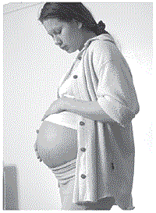
Pregnancy
How is a baby made?

Slide 7
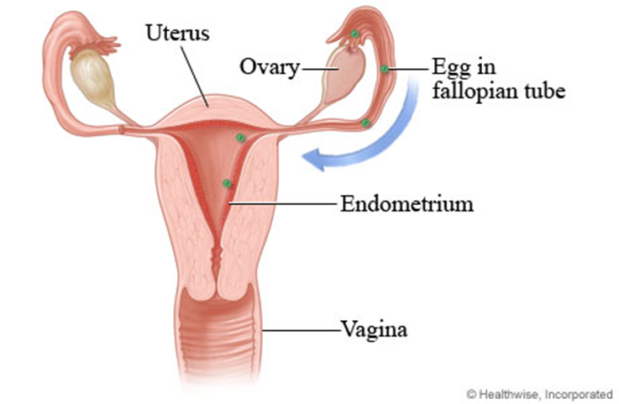
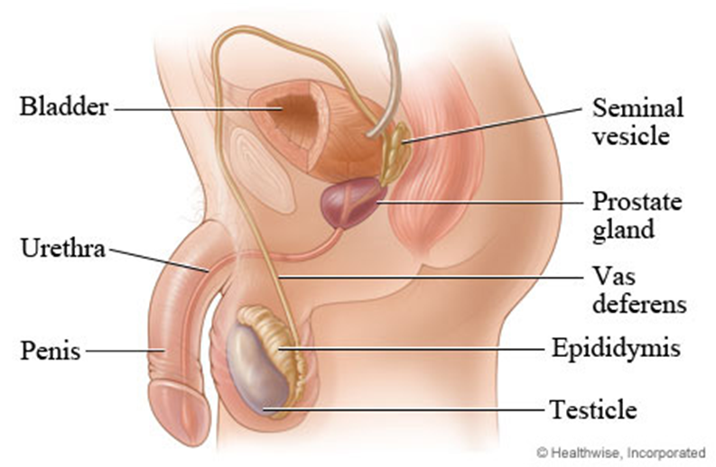
Anatomy Review
Notes:
Before we get started, it’s important that we all know which body parts we’re talking about.
For women, eggs (or ‘ova’) are produced in the ovaries. They travel down the fallopian tube into the uterus. If sperm from the male have travelled up the vagina, then the egg may become fertilized. If the egg is fertilized, it can implant into the endometrium, and the baby can then grow in the uterus.
For men, sperm are produced in the testicles. The sperm mature as they move through the epididymis and vas deferens. Semen is the fluid that leaves a person’s penis when they ejaculate. Semen is made up of sperm and fluids from the prostate gland and seminal vesicles.

Slide 8
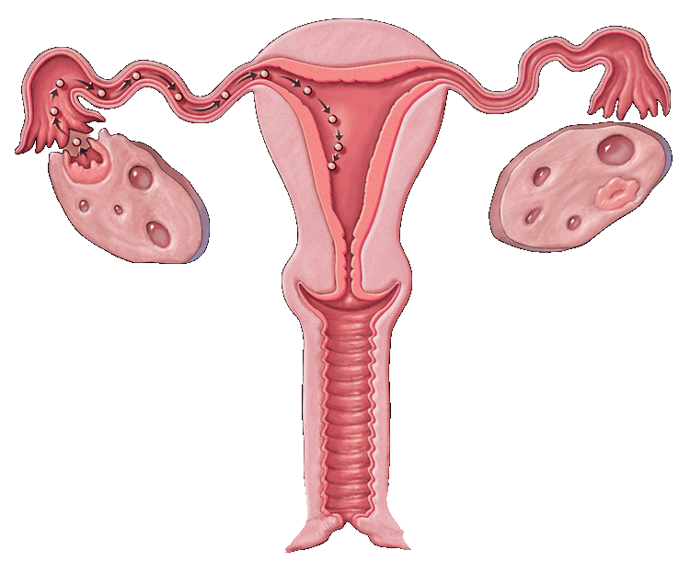
Day 10-14 Ovulation- the mature egg (ovum) is released form the ovary
Day 1 - 6 Menstruation-the lining of the uterus leaves the body
Your Period.
The egg (ovum) moves along the fallopian tube to the uterus
New ovum develops in the ovary
Day 6 -10 An egg matures in the ovary
1 2 3 4 5 6 7 8 9 10 11 12 13 14 15 16 17 18 19 20 21 22 23 24 25 26 27 28
DAY
Notes:
Women and girls who have had their period (or “monthlies”) can get pregnant. Each month, the endometrium grows to create a place for the egg to implant if it is fertilized. If the egg is not fertilized and does not implant, the endometrium releases and is lost as menstrual blood.

Slide 9
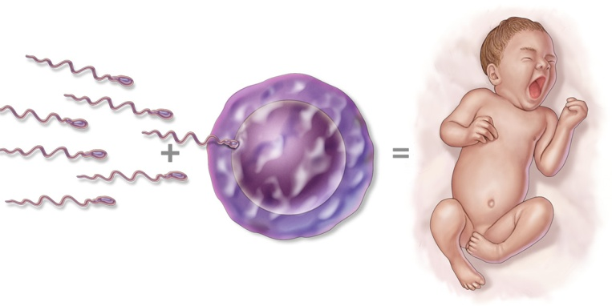
How does pregnancy happen?
After going through puberty, your body is now capable of making a baby.
If a man ejaculates in or near a woman’s vagina:
→ the sperm can swim up through the woman’s vagina, through the uterus, and up the fallopian tubes.
If the man’s sperm meets the woman’s egg, it can result in pregnancy.

Slide 10
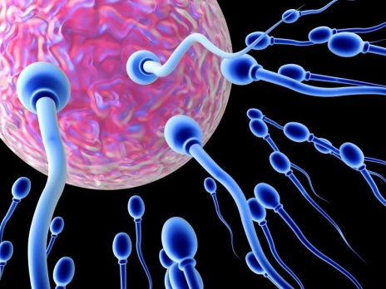
How does pregnancy happen?
Any time two people have sexual intercourse (penis in vagina), the woman can get pregnant.
Not everyone wants to have a baby when they have sex.
In order to prevent pregnancy, you need to stop the sperm from getting to the egg.
Anything that helps stop the sperm from getting to the egg is called “birth control” or “contraception”.

Slide 11
Early signs of pregnancy
Missed period
Sore breasts
Morning sickness – but not just in the mornings!

Slide 12
Activity: True or False?

Slide 13
How would having a baby change your life?
What are the good things about having a baby at a young age?
What are the challenging things about having a baby at a young age?
What are Inuit values around having babies?

Slide 14
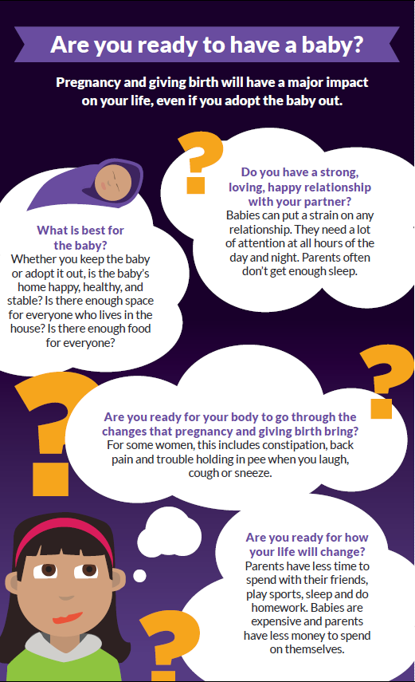
Are you ready?

Slide 15
If you aren’t ready…
Avoid pregnancy in the first place!
Talk to your partner about family planning.
Abstinence (not having sex) is the only GUARANTEED way to prevent pregnancy.
The next best option? Use a condom + another form of family planning.

Slide 16
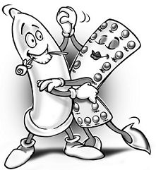
Family Planning/ Birth Control
There are lots of different options for birth control.
All are available at the Health Centre.
Choose a method that works best for you and your lifestyle!
Most are free for Nunavut Inuit, or are covered under health insurance plans.

Slide 17
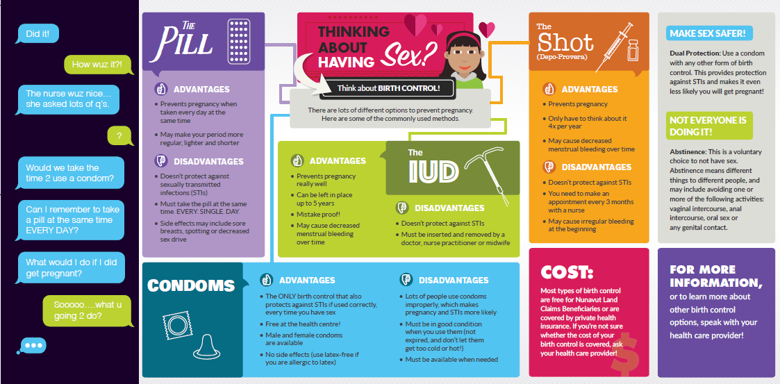
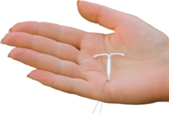
IUD (Intrauterine Device)
Key message: REALLY effective, and can last up to 5 years!
☺ | 😐 | ☹
VERY effective. | Might experience increased blood flow or cramping for a short time. | Does not protect against STIs.
Once it’s in, it can last for 5 years, and you never have to think about it. | Your period could get a bit heavier, or could go away completely .
You can remove it any time, and get pregnant right away. | Has to be put in by a qualified doctor, nurse practitioner, midwife, or nurse – check at your health centre to learn more.
You and your partner can’t feel that it’s there.
Safe for new moms.
Notes:
IUD is great because it lasts for 5 years and you don’t have to think about it. Good for young women, even if they haven’t had a baby.
If you talk about IUD first, girls are more likely to choose it.
☺ - advantages
😐 - information, not good or bad
☹ - disadvantages

Slide 18
Depo-Provera/ The Shot/ The Needle
Key Message: Make sure you get the shot on time! (every 12-13 weeks)
☺ | 😐 | ☹
No one can tell you’re using it. | VERY effective – as long as you get the shot on time! (every 12-13 weeks) | Does not protect against STIs.
Easy to get! Available from nurses at your local health centre. | Most common side effects are irregular bleeding and increased appetite
Can improve the symptoms of PMS, menstrual cramps, and endometriosis. Can decrease risk of anemia and endometrial cancer. | Getting pregnant once you stop – some women can get pregnant immediately, other women might take longer (about nine months)
Usually decreases your period, or might stop it completely.
Safe for new moms.
Notes:
☺ - advantages
😐 - information, not good or bad
☹ - disadvantages

Slide 19
Birth Control Pill
Key message: You MUST take it at the same time. EVERY DAY!
☺ | 😐 | ☹
All health centres have birth control pills! | Effective when taken perfectly – but it’s hard to be perfect! (have to take it at the same time, every day) | Doesn’t protect against STIs.
Protects against endometrial and ovarian cancer, anemia, ovarian cysts, and pelvic inflammatory disease. | Common side effects are irregular bleeding, sore breasts, nausea. These should go away after a while. | Wait 3-6 weeks after giving birth for most types.
May make periods lighter and shorter – or you can skip periods completely!
Notes:
IUD, Depo, and the pill are all really effective methods of birth control – the difference is in how easy it is to make a mistake. It’s easy to make a mistake with the pill, a bit harder to make a mistake with Depo, and really hard to make a mistake with IUD.
☺ - advantages
😐 - information, not good or bad
☹ - disadvantages

Slide 20

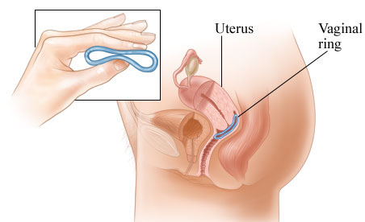
Nuvaring
Key Message: It’s a small, bendable ring worn inside the vagina for three weeks at a time. Use a new ring every month!
☺ | 😐 | ☹
You only need to remember it twice per month (to put it in and take it out) | It’s placed inside the vagina, so it helps if you’re comfortable with your body (it’s similar to using a tampon or menstrual cup) | Does not protect against STIs
Protects against endometrial and ovarian cancer, anemia, ovarian cysts, and pelvic inflammatory disease. | Possible side effects are: bleeding between periods, tender breasts, or nausea and vomiting. These should go away after a while.
May make periods lighter and shorter – or you can skip them completely!
Notes:
☺ - advantages
😐 - information, not good or bad
☹ - disadvantages

Slide 21
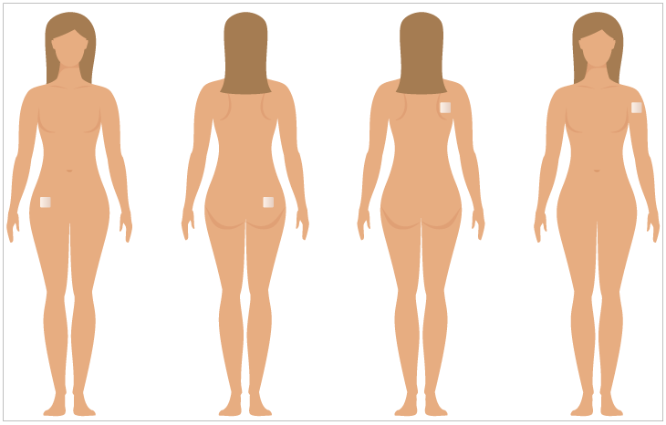
The Patch
Key message: Place it on the bum, stomach, upper outer arm, or shoulder once a week for three weeks, and off for the fourth week!
☺ | 😐 | ☹
May cause more regular, shorter, and lighter periods. | Possible side effects are: bleeding between periods, tender breasts, nausea and vomiting, skin irritation from the patch. Most of these should go away after a while. | Does not protect against STIs.
Only have to change it once per week.
You can get pregnant right after stopping the patch.
Protects against endometrial and ovarian cancer, anemia, ovarian cysts, and pelvic inflammatory disease.
Notes:
☺ - advantages
😐 - information, not good or bad
☹ - disadvantages

Slide 22
A note about side-effects
Common side effects to hormonal birth control are:
  bleeding between periods
  tender breasts
  nausea and vomiting
  A change in sex drive
  Most side-effects should go away after a while.
If you still have uncomfortable side effects after three months, see a nurse or doctor to switch methods (and use a condom to stay protected!).

Slide 23
External (Male) and Internal (Female) Condoms
Key Message: Condoms are the only birth control that also protect against STIs!
☺ | 😐 | ☹
Condoms are the only birth control that protect against STIs (if used correctly) | Some people think condoms decrease sensation or interfere with “the mood”. Try putting a bit of lube in and on the condom, and practice putting them on so it’s easier! | Effective if used perfectly – but almost no one uses it perfectly!
No side effects! (Latex-free condoms are available if you or your partner is allergic to latex)
External condoms are available in every community, free at health centres and some other community locations. Internal condoms are available free in some communities.
Notes:
☺ - advantages
😐 - information, not good or bad
☹ - disadvantages

Slide 24
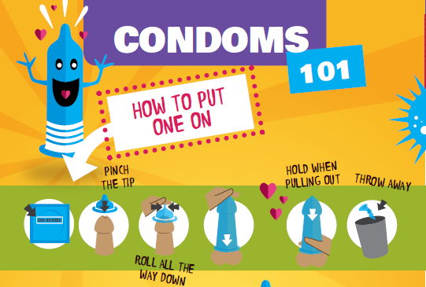
Notes:
Key points
Check the expiration date
Ensure you’re rolling it the right way
Pinch the tip
Roll the condom to the base of the penis
After ejaculation, hold the base of the condom while pulling out
Tie a knot in the condom and throw it in the garbage (not in a toilet!)

Slide 25
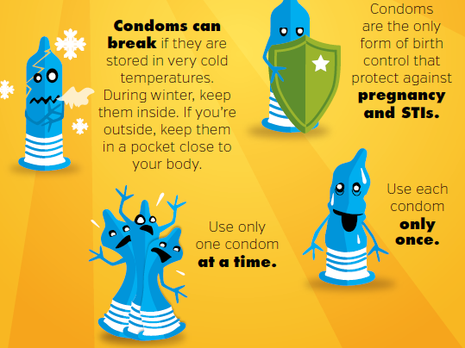

Slide 26
Why didn’t we talk about withdrawal (pulling out)?
Not very effective – it’s hard to pull out in time!
Doesn’t protect against STIs!
Stressful – you have to be worried about your partner pulling out in time!

Slide 27
Emergency Contraception/ Plan B
Can prevent pregnancy after you’ve had unprotected sex.
It’s pretty good, but not as good as some of the other methods of birth control. It’s better to plan ahead!
It’s more effective the sooner you use it after unprotected sex (up to 5 days later).
Available free at all health centres! Also available in pharmacies!

Slide 28
How do I get birth control?
Make an appointment at the health centre – ask for a well-woman check if you’re shy to say what you really want
When you see the nurse, tell her that you want to start using birth control. The nurse can help you decide which type of family planning fits best with your lifestyle.
Check out https://www.bedsider.org/methods/matrix to learn more about the different types of birth control available.

Slide 29
Family Planning
When you think you might have sex sometime in the near future, come to the Health Centre first!
A nurse will talk to you about family planning methods and help you decide which one to choose.

Slide 30
Young people do not need their parent/ guardian’s permission to get birth control.
If you are young, sexually active, and want birth control – make an appointment at the health centre!

Slide 31
I’m pregnant…now what?!
Stop tobacco use and alcohol use.
  If you cannot quit, then reduce as much as possible – although no amount of alcohol is safe during pregnancy.
  Need help to quit or reduce? Visit the health centre!
Think about your options:
  Parenting
  Adoption
  Abortion
Visit the health centre for pre-natal care and discuss what option might be right for you.
If you decide to parent or adopt the baby out, attend CPNP in your community.

Slide 32
Parenting
What are the challenges and benefits of parenting?
Class discussion
Notes:
Emotional cost

Slide 33
Parenting
Are you ready to raise a baby, child, teenager? Think about…
  The emotional cost of raising a child
    It is a life-long commitment to being there for the child
    Think about what supports you have in your life, and who might be able to help you – romantic partner, family, etc.
  The educational cost of raising a child
    Women who have a baby in high school may have more challenges graduating
  The financial cost of raising a child
    Estimated cost in Canada = $234,000* per child
    Diapers, clothes, food
*MoneySense website 2013
Notes:
Emotional cost

Slide 34
Adoption
Adoption means that you will continue the pregnancy and then give up your parental rights to someone else after the baby is born
Women can change their mind about adoption up until the point that the adoption becomes legal

Slide 35
Adoption
What are the challenges and benefits of adoption?
Class discussion
Notes:
What should you consider when considering adoption?

Slide 36
Abortion
Abortion means ending the pregnancy with medication or surgery.
In Nunavut, abortions are available in Iqaluit up to 13 weeks. Travel to Iqaluit is covered.
Abortion is available later than this in other parts of Canada.

Slide 37
Abortion
Abortion does not affect your ability to have other children in the future
The nurse or doctor at the Health Centre can give you more information about this option
Abortion is legal in Canada, and it is always the woman’s decision whether or not to have an abortion

Slide 38
Abortion
What are the challenges and benefits of abortion?
Class discussion

Slide 39
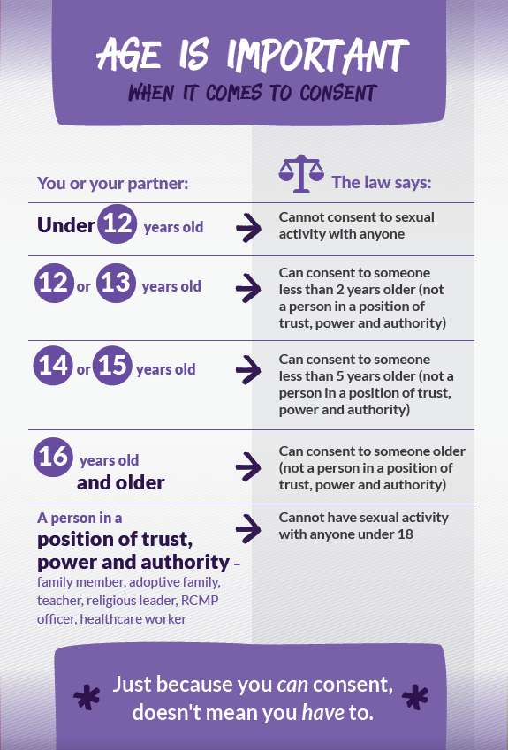
Age of Consent for Sexual Activity

Slide 40
Am I Ready for Sex?
Questions to ask yourself….
Am I being pressured to make a decision?
If the relationship breaks up, will I still be glad that I had sex with this person?
If I have sex will I use effective birth control and STI protection every time?
Am I prepared to deal with the consequences of not practicing safe sex or if the birth control fails (STIs or pregnancy)?
Will I be proud of my decision tomorrow?

Slide 41
Any Questions?

Slide 42
If you aren’t sure what to do…
If you are thinking about sex, thinking about family planning, or pregnant and need someone to talk to:
  Parent, Elder, or another relative you trust
  Nurse, doctor, or CHR
  Kid’s Help Phone: 1-800-668-6868
For more information:
  www.irespectmyself.ca
  www.bedsider.org

