Slide 1

Safer Sex – Information for Educators
January 2017
Please contact sexualhealth@gov.nu.ca if you need support to teach this topic.

Slide 2
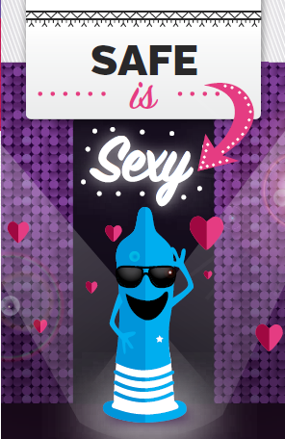

Nunavut-Specific Resources for Teaching Safer Sex
Available at: www.irespectmyself.ca, from local CHR, or by contacting sexualhealth@gov.nu.ca

Slide 3
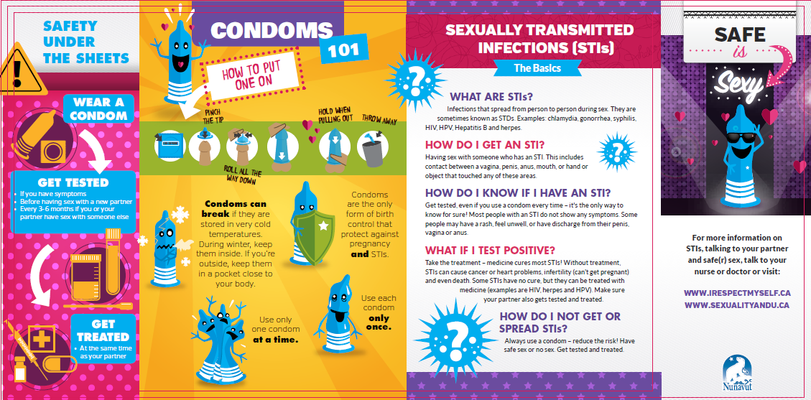
Safe is Sexy! pamphlet

Slide 4
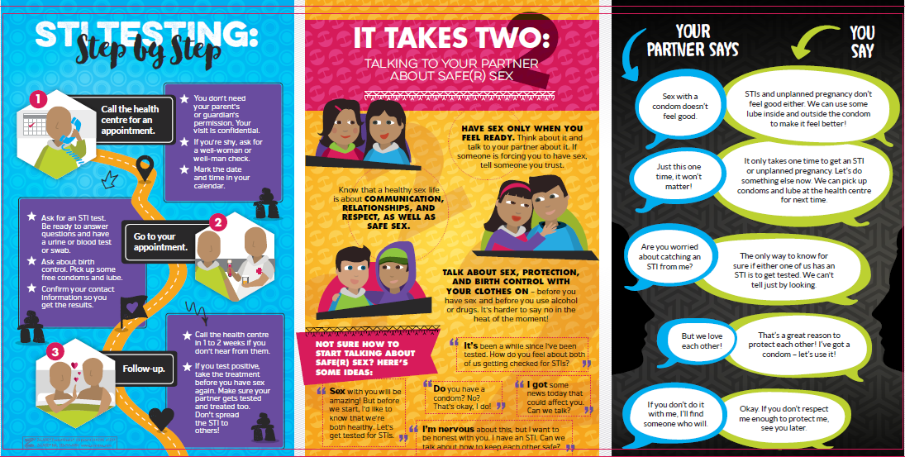

Slide 5
Where to use this resource
Presentations to youth (school, youth groups, etc)
Presentations to CPNP groups
Leave a pile of these anywhere you dispense condoms
As a take-home resource from well-woman, prenatal, or well-man checks
As a give away or prize at health fairs or store booths

Slide 6
Key Messages
Sexually transmitted infections (STIs) can cause cancer, heart problems, infertility (can’t get pregnant) and even death if not treated. They can harm babies if mothers are infected while pregnant.
Most STIs can be cured with medicine. Those that can’t be cured can be treated!
Most people with STIs don’t have symptoms.
If you get tested and treated, make sure your partner(s) also get tested and treated before you have sex with them again.
Notes:
STIs can also cause complications in the baby if a pregnant mother does not get treatment.

Slide 7
STIs: The Basics
STIs can be passed between two people if there is contact between a vagina, penis, anus, mouth, or hand or object that has touched any of these areas
Most people with STIs don’t have any symptoms. Some people have a rash, feel unwell, or have discharge from the penis, vagina, or anus.
People without symptoms can still pass STIs to others!

Slide 8
Safety Under The Sheets
Three steps for STI protection
  Wear a condom
  Get tested
  Get treated
Notes:
If you think you might have had sex without a condom (for example, while drinking or use drugs) – get tested!
Get treated – at the same time as your partner(s)

Slide 9
When should sexually active people get tested for STIs?
If they have symptoms
Before having sex with a new partner
Every 3-6 months if they OR their partner are having sex with anyone else
Get tested even if they use condoms!

Slide 10
Condoms 101
Lube helps reduce the risk of STIs and can improve pleasure while using condoms.
Condoms that have frozen might be more likely to break – keep them inside!
Notes:
Check the expiration date before using a condom.
Lube helps prevent tearing, and can also increase pleasure (for people who say they don’t like the way a condom feels). Use water based lubricant (such as the ones the GN gives out). Place a bit inside the condom and outside. Using petroleum jelly as lube is a bad idea – it can make the condom break!

Slide 11
STI Testing Step By Step
Possible activity: field trip or “open house” at health centre to de-mystify STI testing
Ask for a well-woman or well-man check if shy
Young people don’t need permission from their parents/ guardians for STI testing and treatment
Notes:
F

Slide 12
Talking to your Partner
Healthy sexuality is also about communication, relationships, and respect
Have sex when you feel ready (remember that having sex is not always a choice for everyone)
Talk to your partner before you have sex
Many types of relationships are “normal”
Notes:
Get away from the idea that healthy sexuality is about preventing STIs and unplanned pregnancy. It’s about so much more than that
Have sex only when you feel ready: Having sex is not always a choice for everyone. Educators may not be able to counsel people, but they can say that it’s not ok for someone to force sex upon another person, and encourage them to talk to someone they trust about it.

Slide 13
Your Partner Says/ You Say
Addresses some of the common objections people have to using condoms
Activity: brainstorm objections people have to using condoms. Then ask participants how they could respond.

Slide 14
Choices
Available in all schools in Nunavut: graphic novel, lesson plans, and DVD
Approved by Dept of Education for Grade 7-9 Aulajaaqtut
Themes: sexual health, decision making, peer pressure, healthy relationships, communication, accessing health care

Slide 15
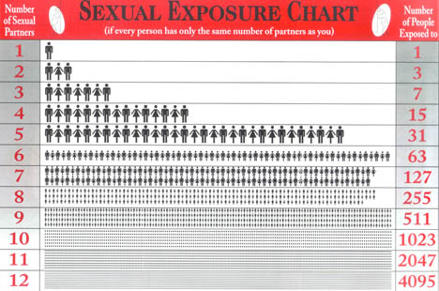
Sexual Exposure Chart
For every partner someone has sex with, it’s like they are also having sex with everyone that person had sex with

Slide 16
Extra note for educators regarding age of consent for STI testing/ treatment and birth control:
Anyone, of any age, can come to the health centre for STI testing/ treatment and birth control.
If the person is young, the nurse may ask a few extra questions to be sure that the person is not being sexually abused and to be sure that the person understands the benefits and risks of treatment.

Slide 17
Our role as sexuality educators
Build our participants’
Knowledge
Skills
Confidence
How can we do this?

Slide 18
Best Ways to Teach
Find out what they already know
Make them feel good about themselves – recognize success!
Make it relevant to their life
Focus on good things – not just fear
Humour – get the giggles out
Drama/ Role Play
Telling stories
Yell out words to get comfortable saying them
Arts and crafts
Songs
Radio and TV script writing
Videos
Activities and games
Debates
Expert groups – have them teach themselves!
Storytelling
Hands-on
Pictures
Guest speakers
Field trips
Question box
Ask questions to check participant’s understanding

Slide 19
Activities for Teaching about Safer Sex
Think-Pair-Share
Gallery Walk
Role Play
True/False
Expert Groups
BINGO
Storytelling – stories, poems, songs
Condom balloons
Debates
Guest speakers
Field trips to the health centre
Games for Adolescent Reproductive Health - http://www.iwtc.org/ideas/10_games.pdf

Slide 20
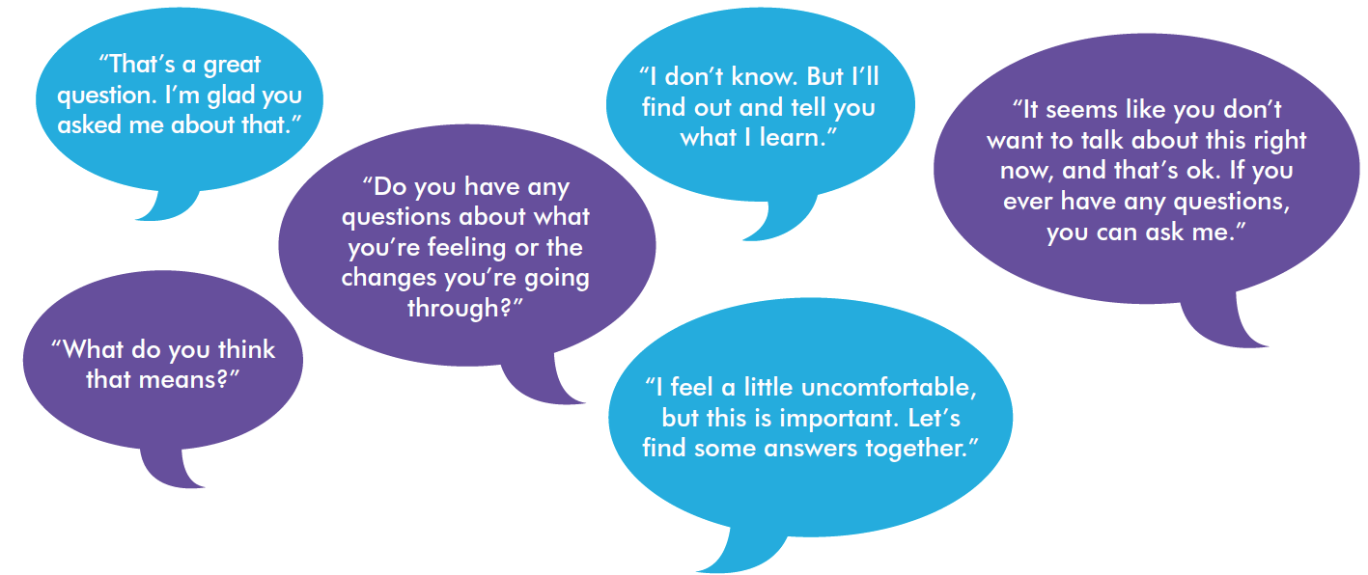
Tips for educators teaching sexual health
Be honest, open, and welcoming
Keep your sense of humour
Don’t worry if the conversation isn’t perfect
Use TV shows, music, movies, the news, and real life to start a conversation.

Slide 21
“People won’t remember what you said or what you did. They will remember how you made them feel.”

Slide 22
Consider…
Asking a respected Elder to come in and speak about the topic to share traditional knowledge and values.
Meet with the Elder in advance to discuss the topic and ensure appropriate, inclusive, and respectful sharing of knowledge. Consider whether there is any potential for hurt or harm in the information being shared.
After the Elder leaves, have a discussion with your group about similarities and differences between traditional and modern knowledge. Be prepared to answer questions with objective, factual, and up-to-date information.

Slide 23
Please review “Teaching Sexual Health – Background Information for Educators” at www.irespectmyself.ca.
Please check out the STIs and Safer Sex Classroom Presentation and Lesson Plan at www.irespectmyself.ca.
Want more information about safer sex?
http://www.irespectmyself.ca/en/having-sex/protect-yourself/safer-sex
http://www.sexandu.ca/stis/
http://www.ippf.org/sites/default/files/2016-10/Putting%20Sexuality%20back%20into%20Comprehensive%20Sexuality%20Education_0.pdf

