Slide 1

Sexual Consent
Date:
Presented by:

Slide 2

Today’s Agenda
Learn what consent is
Learn to recognize consent and non-consent
Learn about ages of consent
Practice asking for consent
Notes:
2

Slide 3
Group Agreement
All questions are ok, at any time.
If someone tells a personal story inside this room, it stays in this room.
Be respectful – we all have our personal values and beliefs. No putting anyone down.
It’s ok to pass.
Have fun learning!
When you see this symbol, we want you to try to answer the question!
Notes:
Write the group agreement on a whiteboard/ chart paper and hang up in the room. If anyone doesn’t follow this agreement, you can say “I want to remind everyone about the group agreement we all agreed to at the beginning of the class”

Slide 4
What is consent?

Slide 5


Three Steps for Consent
Notes:
-Getting consent does not stop at Step 3: respect
-It is an ongoing conversation between partners before and during each new sexual activity
-

Slide 6
Activity: True or False

Slide 7
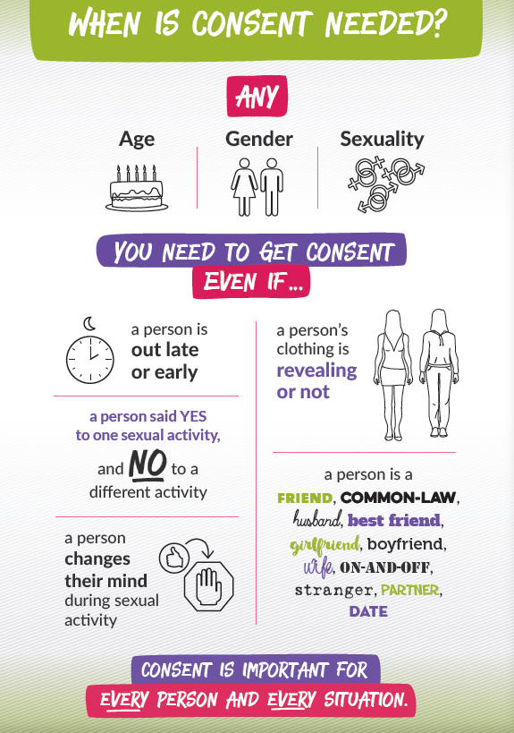
Asking for Consent in Different Situations
Alcohol/ drug use, asleep, unconscious
Pressured or forced

Slide 8
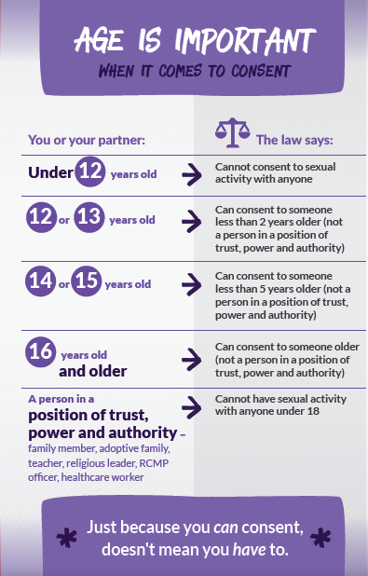

Slide 9
Activity: Parallel Lines

Slide 10


Slide 11
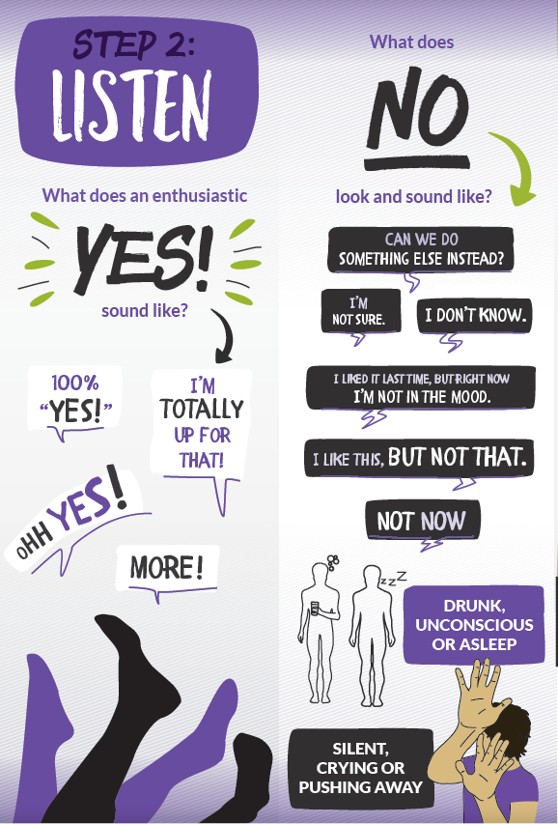

Slide 12
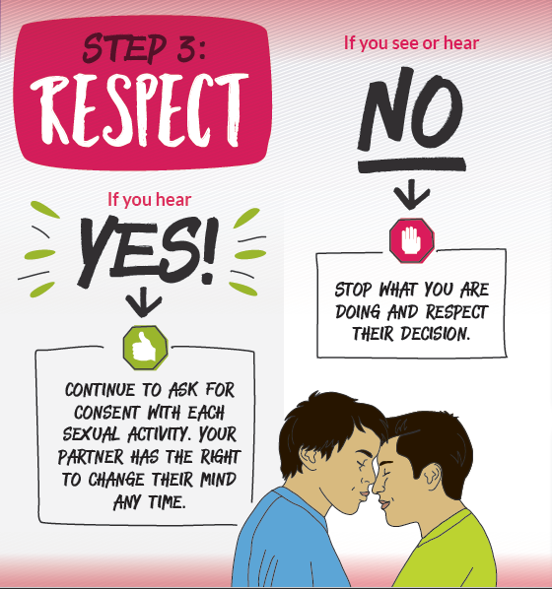

Slide 13
Cup of Tea Consent Video
Cup of Tea Consent Video

Slide 14


Slide 15
Any Questions?

Slide 16

Where can I get more information?
From the Health Centre
  Community Health Representative
  Community Health Nurse or Doctor
From a trusted adult
From websites you can trust
  www.irespectmyself.ca
  www.sexandu.ca
  www.kidshelpphone.ca

