Slide 1

Sexual Consent – Information for Sexual Health Educators
January 2017
Please contact sexualhealth@gov.nu.ca if you need support to teach this topic.

Slide 2


Nunavut-Specific Resources for Teaching about Sexual Consent
Available at: www.irespectmyself.ca, from local CHR, or by contacting sexualhealth@gov.nu.ca

Slide 3
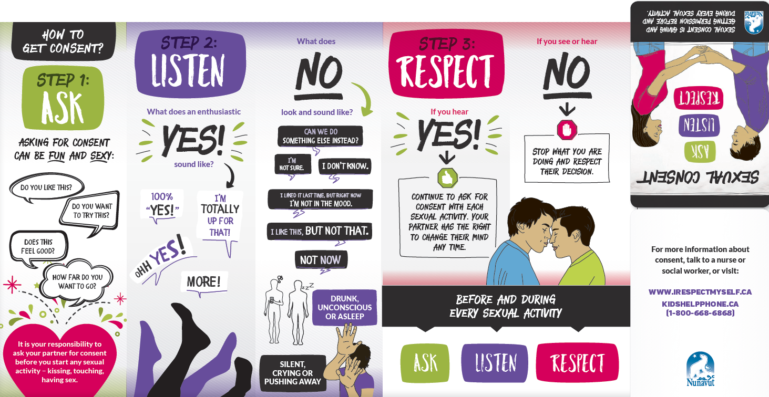
Sexual Consent: Ask, Listen, Respect pamphlet
Available at: www.irespectmyself.ca, from local CHR, or by contacting sexualhealth@gov.nu.ca

Slide 4
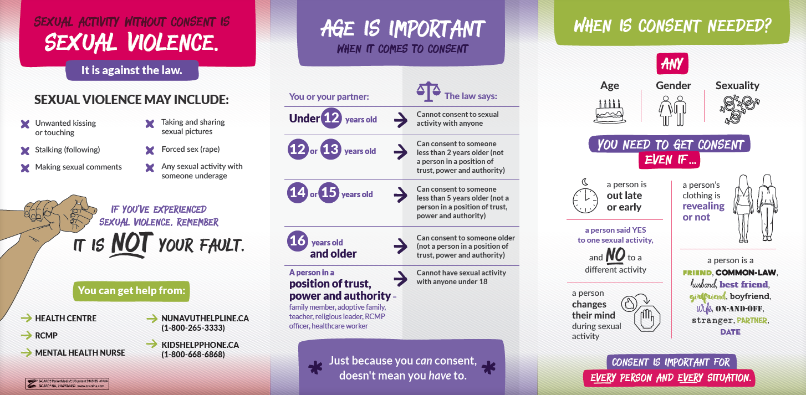

Slide 5

Sexual Consent Poster
Available at: www.irespectmyself.ca, from local CHR, or by contacting sexualhealth@gov.nu.ca

Slide 6
Where to use this resource
Presentations to youth (school, youth groups, etc)
Presentations to CPNP groups, men’s groups, women’s groups, parents’ groups
Leave a pile of these anywhere you dispense condoms
As a take-home resource from well-woman, prenatal, or well-man checks
As a give away or prize at health fairs or store booths
Posters – school, health centre, post office, grocery store…

Slide 7
Key Messages
Sexual consent is asking for permission before and during every sexuality activity.
There are three steps to sexual consent: Ask, Listen, and Respect.
Practice consent in all your relationships.
Just because someone CAN consent, doesn’t mean they HAVE to consent.

Slide 8

Ask
There are different ways to ask for consent.
Whoever is starting or continuing the sexual activity has to ask for consent – males and females!
Sexual activity = kissing, touching, having sex, cyber sex, oral sex, sexting, taking or sharing sexual photos…

Slide 9
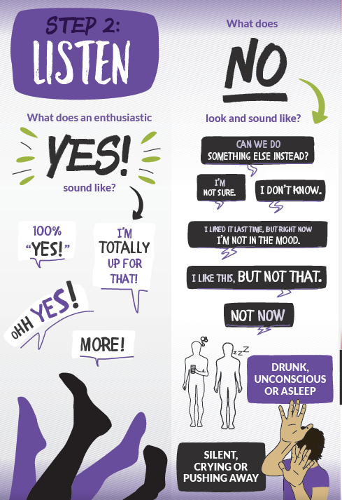
Listen
Build skills to recognize “yes” and “no.”
The “Yes!” must be voluntary, enthusiastic, and active.
“No” can be communicated in words or actions.

Slide 10
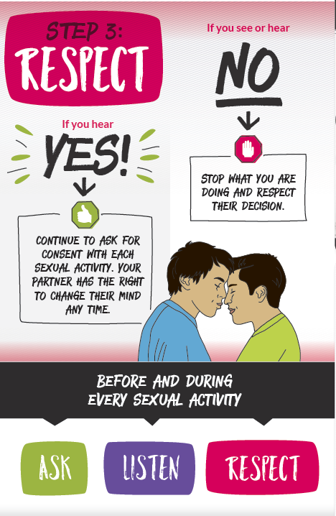
Respect
Consent is ongoing.
Someone can change their mind at any time.

Slide 11
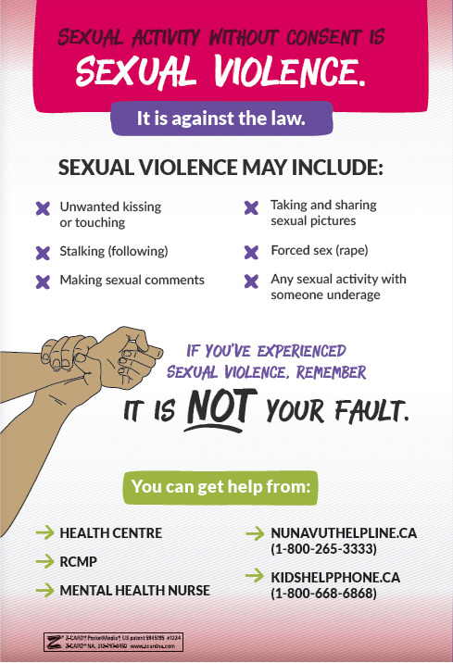
De-normalize sexual violence.
For people who’ve experienced sexual violence, give them resources and reassure that it’s not their fault.

Slide 12
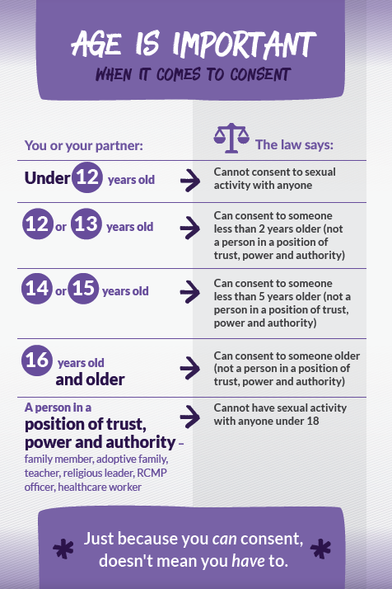
Age of Consent
Just because someone CAN consent, doesn’t mean they HAVE to consent.

Slide 13
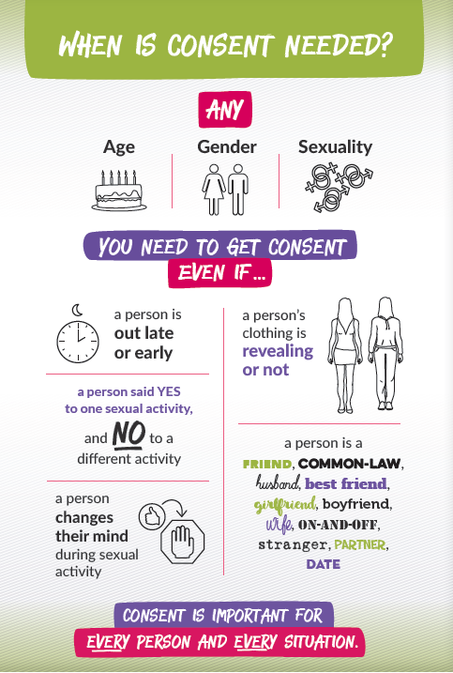
Reminder!

Slide 14
Choices
Available in all schools in Nunavut: graphic novel, lesson plans, and DVD
Approved by Dept of Education for Grade 7-9 Aulajaaqtut
Themes: sexual health, decision making, peer pressure, healthy relationships, communication

Slide 15
Cup of Tea Consent Video
http://www.irespectmyself.ca/sites/default/files/public/video/tea_and_consent_clean-sd.mp4

Slide 16
Extra note for educators regarding age of consent for STI testing/ treatment and birth control:
Anyone, of any age, can come to the health centre for STI testing/ treatment and birth control.
If the person is young, the nurse may ask a few extra questions to be sure that the person is not being sexually abused and to be sure that the person understands the benefits and risks of treatment.

Slide 17
Our role as sexuality educators
Build our participants’
Knowledge
Skills
Confidence
How can we do this?

Slide 18
Best Ways to Teach
Find out what they already know
Make them feel good about themselves – recognize success!
Make it relevant to their life
Focus on good things – not just fear
Humour – get the giggles out
Drama/ Role Play
Telling stories
Yell out words to get comfortable saying them
Arts and crafts
Songs
Radio and TV script writing
Videos
Activities and games
Debates
Expert groups – have them teach themselves!
Storytelling
Hands-on
Pictures
Guest speakers
Field trips
Question box
Ask questions to check participant’s understanding

Slide 19
Activities for Teaching about Sexual Consent
Parallel Lines
Think-Pair-Share
Gallery Walk
Role Play
True/False
Expert Groups
BINGO
Storytelling – stories, poems, songs
Condom balloons
Debates
Guest speakers
Field trips to the health centre
Games for Adolescent Reproductive Health - http://www.iwtc.org/ideas/10_games.pdf

Slide 20
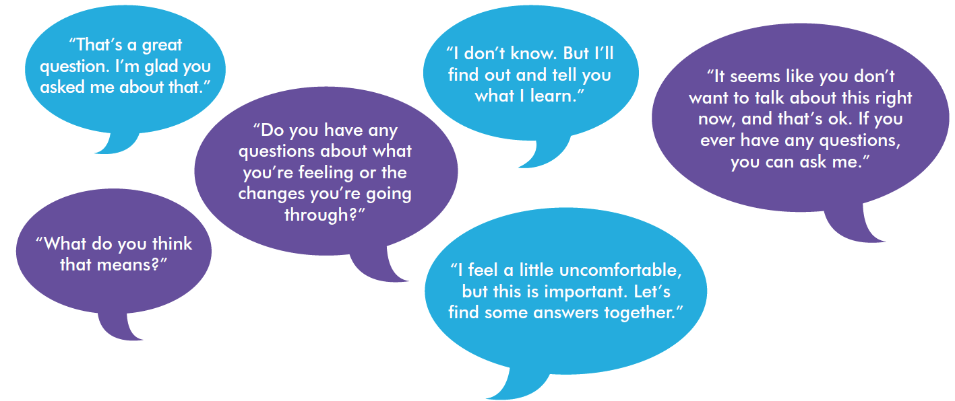
Tips for educators teaching sexual health
Be honest, open, and welcoming
Keep your sense of humour
Don’t worry if the conversation isn’t perfect
Use TV shows, music, movies, the news, and real life to start a conversation.

Slide 21
“People won’t remember what you said or what you did. They will remember how you made them feel.”

Slide 22
Consider…
Asking a respected Elder to come in and speak about the topic to share traditional knowledge and values.
Meet with the Elder in advance to discuss the topic and ensure appropriate, inclusive, and respectful sharing of knowledge. Consider whether there is any potential for hurt or harm in the information being shared.
After the Elder leaves, have a discussion with your group about similarities and differences between traditional and modern knowledge. Be prepared to answer questions with objective, factual, and up-to-date information.

Slide 23
Please review “Teaching Sexual Health – Background Information for Educators” at www.irespectmyself.ca.
Please check out the “Sexual Consent” Classroom Presentation and Lesson Plan at www.irespectmyself.ca.
Want more information about sexual consent?
http://www.irespectmyself.ca/en/sex-101/consent
http://www.sexandu.ca/consent/
https://www.kidshelpphone.ca/Teens/InfoBooth/Money-jobs-laws/Laws/The-law-and-your-body.aspx
https://www.kidshelpphone.ca/Teens/InfoBooth/Sexting/Consent.aspx

