Slide 1
Sexually Transmitted Infections – Information for Educators
January 2017
Please contact sexualhealth@gov.nu.ca if you need support to teach this topic.

Slide 2
Nunavut-Specific Resources for Teaching about Sexually Transmitted Infections
http://www.irespectmyself.ca/en/having-sex/stis/what-are-stis
Bacterial STIs (chlamydia, gonorrhea, syphilis) http://www.irespectmyself.ca/having-sex/stis/bacterial-stis
Viral STIs (HPV, genital herpes, Hepatitis B, HIV/ AIDS) http://www.irespectmyself.ca/en/having-sex/stis/viral-stis
Parasitic STIs (trichomoniasis, scabies, public lice) http://www.irespectmyself.ca/en/having-sex/stis/parasitic-stis

Slide 3
Choices
Available in all schools in Nunavut: graphic novel, lesson plans, and DVD
Approved by Dept of Education for Grade 7-9 Aulajaaqtut
Themes: sexual health, decision making, peer pressure, healthy relationships, communication

Slide 4
STIS: Key messages
STIs can be transmitted through vaginal, anal, or oral sex with someone who has an STI. Some STIs are also spread through blood, or from pregnant mothers to their unborn babies.
Most people with STIs don’t have any symptoms. Some people have a rash, feel unwell, or have discharge from the penis, vagina, or anus.
People without symptoms can still pass STIs to others – always use a condom!
Get tested for STIs (even if you use a condom):
If you have symptoms
Before having sex with a new partner
If you or your partner are having sex with anyone else

Slide 5
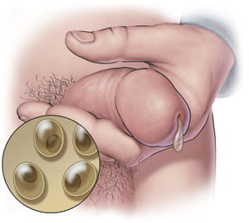
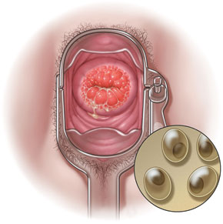
Chlamydia and Gonorrhea
How spread | Through unprotected oral, anal, or vaginal sex. Infected mothers can infect their baby during birth.
Symptoms | Most people have no symptoms. People who do have symptoms might experience: Unusual discharge from vagina, penis, or anus Burning sensation when peeing Stomach or lower back pain (females) Painful testicles (males)
Testing | Urine or swab
Treatment | Can cure with medication.
Risks with no treatment | Infertility (no babies) Pain Increases your risk to get other STIs if exposed to them
Prevention | Use a condom and/or dental dam every time you have oral, anal, or vaginal sex. Get tested at your local health centre if you have symptoms, before having sex with a new partner, and every 3-6 months if you or your sexual partners have more than one partner.
Images from www.sexualityandu.ca

Slide 6
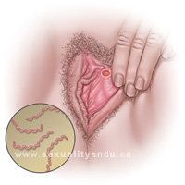
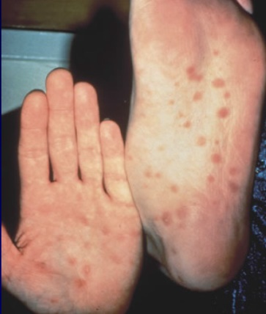
Syphilis
How spread | Through unprotected oral, anal, or vaginal sex. Infected mothers can infect their baby during birth.
Symptoms | Most people do not have or notice the symptoms. People with syphilis might experience: 1st stage – painless sores 2nd stage - flu-like symptoms (fever, muscle pain), body rash 3rd stage - major damage to eyes, ears, heart
Testing | Blood test
Treatment | Can cured with antibiotics.
Risks with no treatment | Blindness Brain damage Heart damage Increases your risk to get other STIs if exposed to them Death Babies born to infected mothers can be really sick or die
Prevention | Use a condom and/or dental dam every time you have oral, anal, or vaginal sex. Get tested at your local health centre at least once a year if you’re sexually active under age 30 Get tested at your local health centre if you have symptoms, before having sex with a new partner, and every 3-6 months if you or your sexual partners have more than one partner.
Images from www.sexualityandu.ca and http://www2a.cdc.gov/stdtraining/ready-to-use/Manuals/Syphilis/syphilis-slides-2013.pdf

Slide 7
HIV/AIDS
How spread | Through unprotected oral, anal, or vaginal sex. Passed through breast milk and blood. Infected mothers can infect their baby during birth. Unsterilized tattooing equipment
Symptoms | Symptoms may take years to show. The symptoms of HIV are: Weight loss Tired Fever HIV causes AIDS—the immune system becomes very weak and cannot fight off infections.
Testing | Blood test
Treatment | No cure (the person will always have HIV). Good treatment is available.
Risks with no treatment | Weakened immune system More infections Death
Prevention | Use a condom and/or dental dam every time you have oral, anal, or vaginal sex. Get tested at your local health centre at least once a year if you’re sexually active under age 30 Get tested at your local health centre if you have symptoms, before having sex with a new partner, and every 3-6 months if you or your sexual partners have more than one partner.
Images from www.sexualityandu.ca

Slide 8
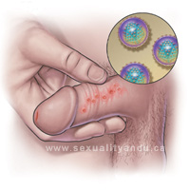
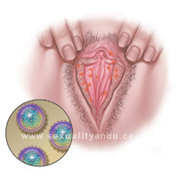
Genital Herpes
How spread | Through unprotected oral, anal, or vaginal sex. Infected mothers can infect their baby during birth.
Symptoms | Blisters (small fluid-filled sores) Burning sensation when peeing Itchiness Some people don’t have any symptoms
Testing | Swab or blood test
Treatment | No cure (virus stays in body). Manage symptoms with medication.
Risks with no treatment | Brain damage and blindness in babies born to infected mothers Increases your risk to get other STIs if exposed to them
Prevention | Use a condom and/or dental dam every time you have oral, anal, or vaginal sex. Get tested at your local health centre if you have symptoms.
Images from www.sexualityandu.ca

Slide 9
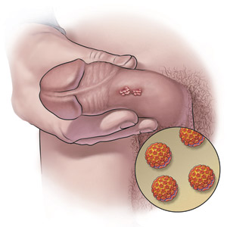
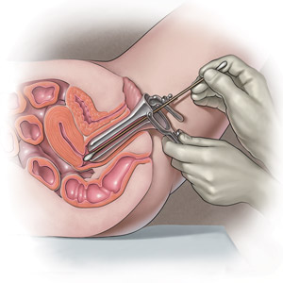
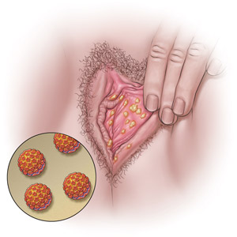
HPV (Human Papilloma Virus)
How spread | Through unprotected oral, anal, or vaginal sex. Rarely, infected mothers can infect their baby during birth.
Symptoms | There are many different types of HPV. Some cause genital warts for men and women —cauliflower-like bumps. Some people have no symptoms.
Testing | Visual exam PAP test
Treatment | No cure—virus stays in body. Vaccines prevent the most common types of HPV. Manage symptoms with medication. Most genital warts go away on their own.
Risks with no treatment | Distress Increases your risk to get other STIs if exposed to them Cancer
Prevention | Get the vaccine (available for free to all Grade 6 girls in Nunavut) Use a condom and/or dental dam every time you have oral, anal, or vaginal sex. Get tested at your health centre once you become sexually active, and every 5 years if the test is negative and you’re over age 21.
Images from www.sexualityandu.ca

Slide 10
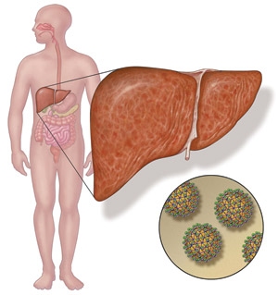
Hepatitis B
How spread | Through unprotected oral, anal, or vaginal sex. Infected mothers can infect their baby during birth.
Symptoms | Flu-like (fever, tired, body aches, stomach pain, nausea) Jaundice (yellow skin) Some people have no symptoms
Testing | Blood test
Treatment | No cure (virus stays in body). Prevent with vaccine.
Risks with no treatment | Liver damage Cancer Death
Prevention | Get the vaccine (given to all babies in Nunavut) Use a condom and/or dental dam every time you have oral, anal, or vaginal sex. Get tested at your local health centre if you have symptoms, before having sex with a new partner, and every 3-6 months if you or your sexual partners have more than one partner.
Images from www.sexualityandu.ca

Slide 11
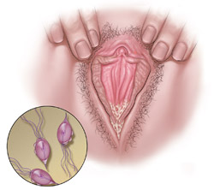
Trichomoniasis
How spread | Through unprotected oral, anal, or vaginal sex
Symptoms | Unusual discharge from vagina or penis Itchiness Burning sensation when peeing Painful sex (females) Some people have no symptoms
Testing | Swab
Treatment | Can cure with medication
Risks with no treatment | Chronic pain Infertility (no babies) Increases your risk to get other STIs if exposed to them
Prevention | Use a condom and/or dental dam every time you have oral, anal, or vaginal sex. Get tested at your local health centre.
Images from www.sexualityandu.ca

Slide 12
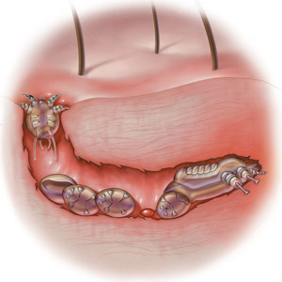
Scabies
How spread | Close contact with infected person.
Symptoms | Skin that is itchy, red, and inflamed
Testing | Visual test or swab
Treatment | Can cure with special lotion. Wash other infected items (clothes, bedding, towels) in hot water, or keep in sealed bag for 1 week.
Risks with no treatment | Constant scratching can cause infections
Prevention | Do not share unwashed towels and clothing.
Images from www.sexualityandu.ca

Slide 13
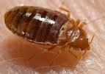
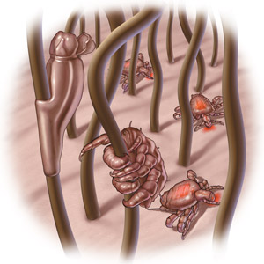
Public Lice
How spread | Close contact with an infected person.
Symptoms | Itchy and red skin Tiny oval-shaped eggs in pubic hair Tiny black dots on underwear (lice poop)
Testing | Visual test
Treatment | Can cure with special shampoo. Use a fine comb to scrape eggs out of hair. Wash other infected items (clothes, bedding, towels) in hot water, or keep in sealed bag for one week.
Risks with no treatment | Constant scratching can cause infections.
Prevention | Do not share unwashed towels and clothing.
Images from www.sexualityandu.ca

Slide 14
STI Testing Step By Step
Possible activity: field trip or “open house” at health centre to de-mystify STI testing
Ask for a well-woman or well-man check if shy
Young people don’t need permission from their parents/ guardians
Notes:
F

Slide 15
Our role as sexuality educators
Build our participants’
Knowledge
Skills
Confidence
How can we do this?

Slide 16
Best Ways to Teach
Find out what they already know
Make them feel good about themselves – recognize success!
Make it relevant to their life
Focus on good things – not just fear
Humour – get the giggles out
Drama/ Role Play
Telling stories
Yell out words to get comfortable saying them
Arts and crafts
Songs
Radio and TV script writing
Videos
Activities and games
Debates
Expert groups – have them teach themselves!
Storytelling
Hands-on
Pictures
Guest speakers
Field trips
Question box
Ask questions to check participant’s understanding

Slide 17
Activities for Teaching about STIs
Gallery Walk
True/False
Expert Groups
BINGO
Guest speakers
Field trips to the health centre
Games for Adolescent Reproductive Health - http://www.iwtc.org/ideas/10_games.pdf

Slide 18
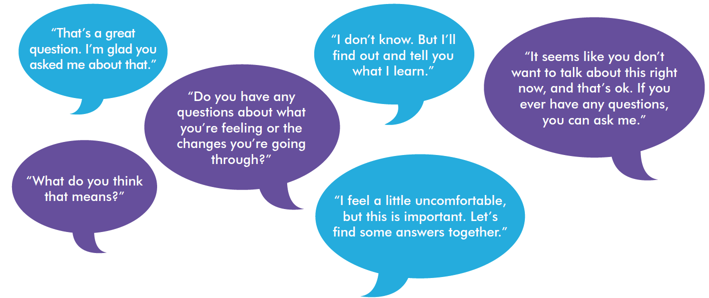
Tips for educators teaching sexual health
Be honest, open, and welcoming
Keep your sense of humour
Don’t worry if the conversation isn’t perfect
Use TV shows, music, movies, the news, and real life to start a conversation.

Slide 19
“People won’t remember what you said or what you did. They will remember how you made them feel.”

Slide 20
Please review “Teaching Sexual Health – Background Information for Educators” at www.irespectmyself.ca.
Any time we talk about STIs, we should also talk about safer sex. Please check out the “Safer Sex – Information for Educators” powerpoint at www.irespectmyself.ca
Please check out the “STIs and Safer Sex” Classroom Presentation and Lesson Plan at www.irespectmyself.ca.
Want more information about STIs?
www.sexandu.ca/stis

