Slide 1

Sexually Transmitted Infections (STIs) and Safer Sex
Date:
Presented By:

Slide 2

Today’s Agenda
Sexually Transmitted Infections (STIs)
Safer Sex
Notes:
2

Slide 3
Group Agreement
All questions are ok, at any time.
If someone tells a personal story inside this room, it stays in this room.
Be respectful – we all have our personal values and beliefs. No putting anyone down.
It’s ok to pass.
Have fun learning!
When you see this symbol, we want you to try to answer the question!
Notes:
Write the group agreement on a whiteboard/ chart paper and hang up in the room. If anyone doesn’t follow this agreement, you can say “I want to remind everyone about the group agreement we all agreed to at the beginning of the class”

Slide 4
Talking About Our Bodies
“But I don’t like to hear about private body parts!”
Sometimes it can feel uncomfortable or funny to talk about our bodies… and that’s okay!
It is really important to understand your own body and be able to use the correct words.
The more we talk about it, the more we learn and the more comfortable we feel. ☺
Notes:
Some students will say “But I don’t like to hear about private body parts!”

Slide 5
Talking About Our Bodies
“But I’m not even interested in having sex! Why should we even talk about it?”
We want everyone to have the information about their bodies and their sexual health, long before you even consider having sex.
Even if you never have sex, it’s still important to know about your own body!

Slide 6
Icebreaker: Condom Balloons
Check the expiry date on the condoms (they’re more likely to break if they’re expired!)
Who can blow the biggest balloon?

Slide 7
What are sexually transmitted infections?

Slide 8
What are sexually transmitted infections?
Syphilis
Chlamydia
Gonorrhea
HIV/AIDS
Hepatitis B
Genital Herpes
Trichomoniasis
Pubic lice
Scabies

Slide 9
How do we get sexually transmitted infections?
From a person who has an STI
Vaginal, anal, or oral sex
Mutual masturbation
Sharing sex toys
Mother to baby
Shared needles, tattooing or piercing equipment
Some can be passed even if using condoms

Slide 10
Activity: Virus Carrier Handshake

Slide 11
Why do we want to avoid STIs?

Slide 12
Why do we want to avoid STIs?
Untreated STIs can cause:
  Infertility (being unable to have a baby)
  Damage to your heart, brain, ears, and eyes
  Cancer
  Death
Some STIs can be cured.
Others can’t be cured (you will always have it), but there is good treatment available to help control the disease.

Slide 13
What are STI symptoms?

Slide 14
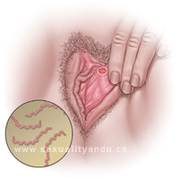
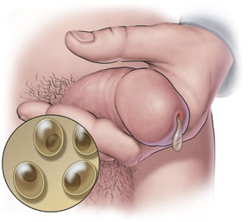
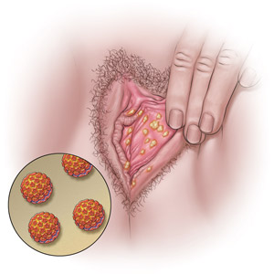
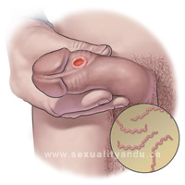
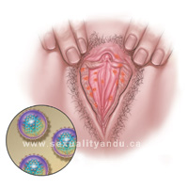
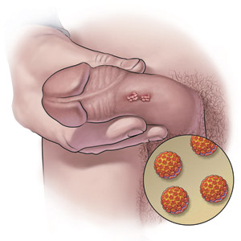
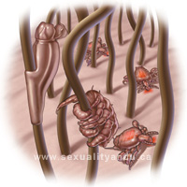
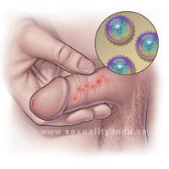
What are STI symptoms?
Many people who have STIs have NO symptoms!
Each STI has different symptoms, but some common ones are:
  Discharge from the penis, vagina, or anus
  Pain in testicles, lower back, abdomen, or during sex
  Burning feeling when peeing
  Painless sore
  Rash (often on feet or hands)
  Blisters, warts, or itchiness around genitals

Slide 15
How can we prevent STIs?

Slide 16
How can we prevent STIs?
Abstinence
Wearing condoms
Get tested for STIs:
  If you have symptoms
  Before having sex with a new partner
  Every 3-6 months if you or your partner are having sex with anyone else
  Make sure your partner gets tested too!

Slide 17
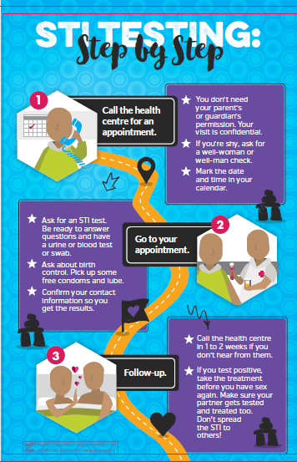

Slide 18
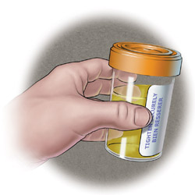
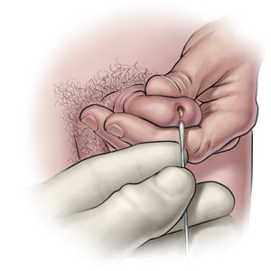
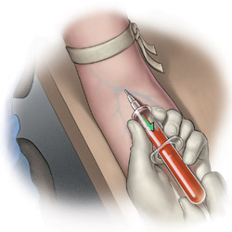
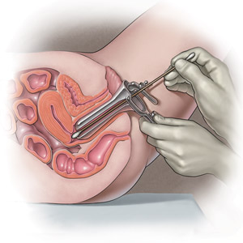
What happens during STI testing?
﻿Urine sample
﻿Penile Swab
﻿Cervical and Vaginal Swabs
﻿Blood test

Slide 19
Activity!
What response can you give if your partner says these things to you?
  You want to use condoms, but your partner says “I don’t want to use condoms because I don’t like the way they feel.” What do you say?
  You want to get tested for STIs, but your partner says “What, do you think I’m sleeping around?” What do you say?
  You are starting a new relationship, and want you and your partner to get tested for STIs. What do you say to your partner?
  You want to use condoms, but your partner says “But we love each other!” What do you say?

Slide 20
Any Questions?

Slide 21

Where can I get more information?
From the Health Centre
  Community Health Representative
  Community Health Nurse or Doctor
From a trusted adult
From websites you can trust
  www.irespectmyself.ca
  www.sexandu.ca

