Slide 1

Talking to our Children about Sexuality
Date:
Presented by:

Slide 2
Today’s Agenda
Learn what we mean when we talk about “sexuality” or “sexual health”.
Learn what we should tell our children about sexuality at a variety of ages.
Practice answering common questions that children ask.
Notes:
2

Slide 3
Group Agreement
All questions are ok, at any time.
If someone tells a personal story inside this room, it stays in this room.
No judgement – we all have our personal values and beliefs.
No putting anyone down.
Have fun learning!
When you see this symbol, we want you to try to answer the question!
Notes:
Write the group agreement on a whiteboard/ chart paper and hang up in the room. If anyone doesn’t follow this agreement, you can say “I want to remind everyone about the group agreement we all agreed to at the beginning of the class”

Slide 4

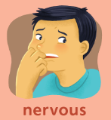
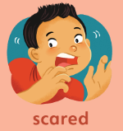


Icebreaker
Make a face on a post it note – how do you feel about talking to the children and youth in your life about sexual health?

Slide 5
Icebreaker
Place your post it note on a line (from not important to very important) – how important is it to talk about sexual health with the children and youth in your life?
Not Important
Very Important

Slide 6
What is sexual health/ sexuality?

Slide 7
What is sexual health/ sexuality?
Values – what is important to us
Communication – how we talk to others
Relationships
Body Image and Self-Esteem – how we feel about ourselves
Anatomy and Physiology – body parts
Sexuality
Physical Expression (sex)
Sexual orientation, gender roles, identity
Decision Making

Slide 8
Why do we need to start talking about sexuality when children are young?
Because sexuality is about communication, relationships, feelings, and self-esteem.
When we talk about communication, relationships, feelings, and self-esteem at a young age, children learn how to behave as adults.

Slide 9
When our children are adults, we want them to…
Notes:
Be Happy
Be Healthy
Be Safe
Have Good relationships
Have Children
Feel good about their bodies
Wait until they are ready to have sex

Slide 10
Talking to our children about sexual health can help our children to:
  Be safe
  Be happy
  Be healthy
  Have good relationships
  Feel good about their bodies
  Have children when they’re ready
  Wait until they are ready to have sex
Notes:
Doesn’t make them more likely to have sex.
If they are not learning from you, they are learning from TV, movies, music, and their friends. Often, the information they get from those sources is wrong. If we want them to have the right information, we need to talk to them.

Slide 11
Children and youth need different information at different ages

Slide 12
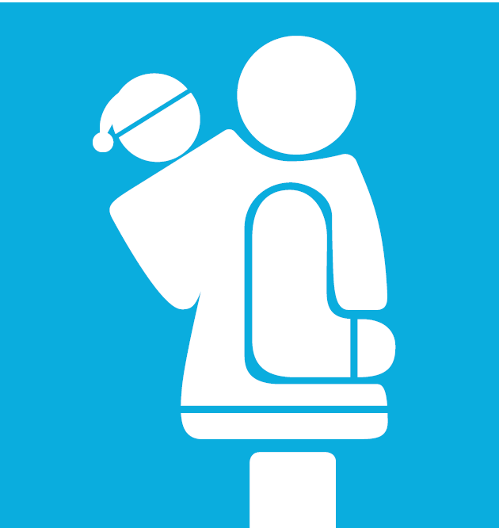
Ages 0-2
Name body parts
  penis, vagina, bum, breasts
Notes:
Is this easy/ hard? Is it easier/ harder to use Inuktitut/ Innuinaqtun than English?

Slide 13
Ages 2-7
Public and private parts and activities.
Who can touch them, when. Be specific!
Safe and unsafe touch. Tell them to tell you, that you won’t be mad, and it’s not their fault.
Recognize and name feelings.
Answer questions simply.
Notes:
Be specific.
It’s ok if mummy or daddy helps you wipe after you go to the bathroom.
It’s ok if the nurse or doctor needs to check your private parts, as long as mummy or daddy are there.
It’s ok if someone is helping you get dressed.
If someone asks you to touch their private parts, that’s not ok.

Slide 14
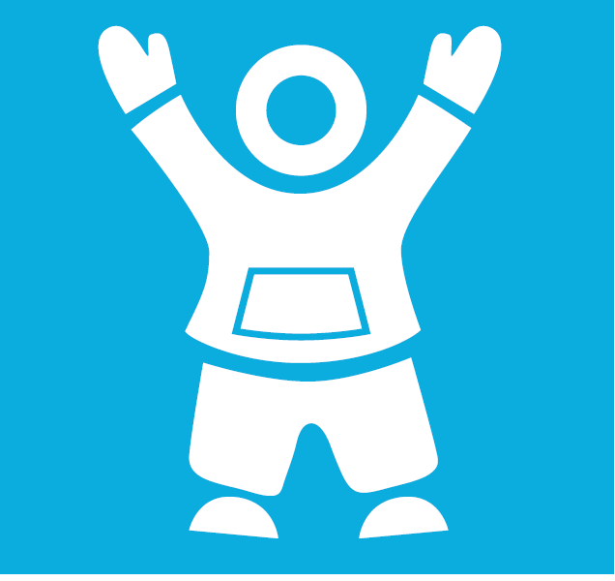
Ages 7-12
How babies are made
Family values and expectations
Build self-esteem
Puberty (age 8-9)
Sexually transmitted infections and birth control (ages 10-12)
Notes:
Some family values might be – I want you to be older when you have sex. I want you to be married when you have sex. I want you to finish school before you have a baby. I want you to respect your partner.
Around this age, they start to hear things from their friends. Better to hear them an adult who cares about them, to make sure the information is correct.

Slide 15
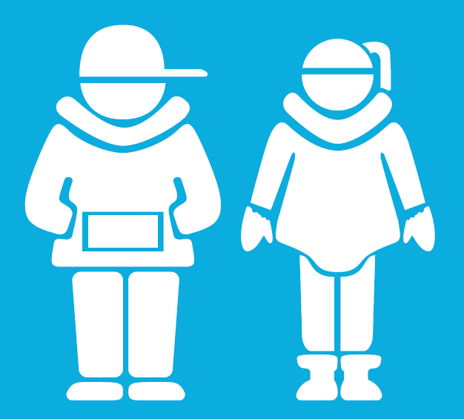
Ages 13-18
Start conversations
More detail - STIs and birth control
Healthy and unhealthy relationships
Decision making – be specific!
Build self-esteem
Promote safety
Build skills, including communication
Notes:
“Safer sex” = if someone decides to have sex, how can they make it as safe as possible? Use condoms. Use birth control. Get tested regularly for STIs. Talk to their partner.

Slide 16
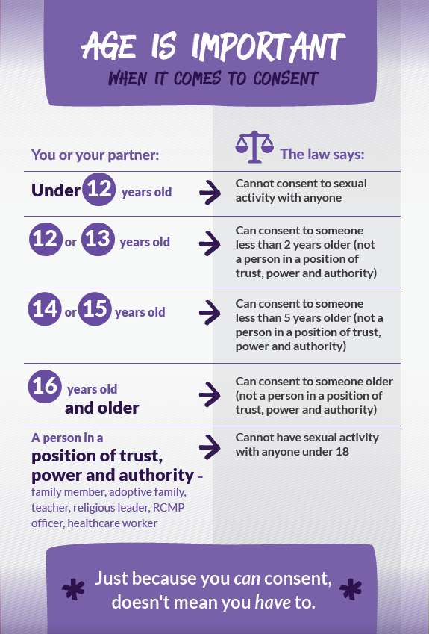
Age of Consent for Sexual Activity

Slide 17
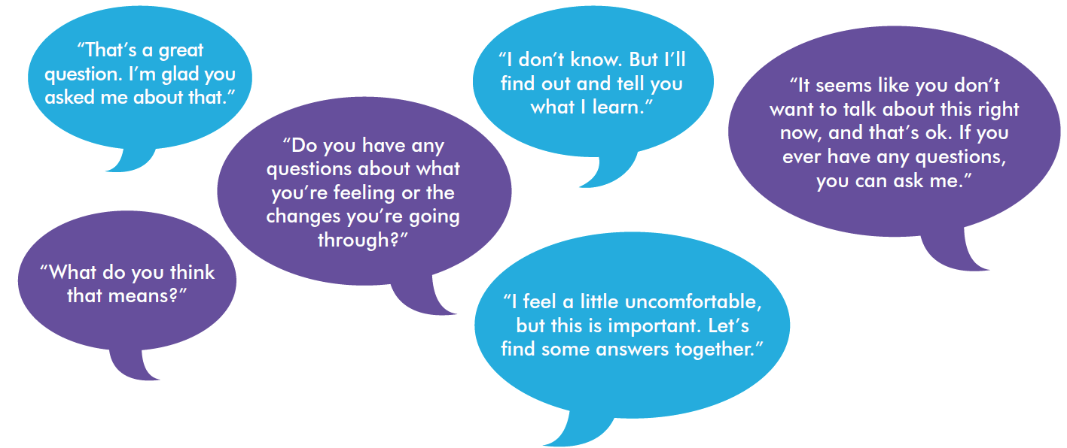
Tips for parents
Be honest, open, and welcoming
Keep your sense of humour
Don’t worry if the conversation isn’t perfect
Use TV shows, music, movies, the news, and real life to start a conversation.
Share your family values and expectations.

Slide 18
Activity 1: Gallery Walk
Common Questions Kids Ask!
Each group will come up with age-appropriate answers for the following questions:
  Question 1
  Question 2
  Question 3
Notes:
You can do this as a large group, or in small groups – each group takes a question or two and comes up with some answers.

Slide 19
Activity 2: Teachable Moments
Each group is given a “teachable moments” scenario
The group will decide how to respond to the scenario as a parent/ caregiver
Each group will act out their scenario and response for the larger group

Slide 20
We can raise our children to be happy, healthy, and safe!

Slide 21
More Information
http://www.upworthy.com/5-everyday-ways-to-teach-your-kids-about-consent
http://parents.teachingsexualhealth.ca/topics/resources.html
www.inuithealthmatters.aboutkidshealth.ca/

Slide 22
Questions?
Thank you!

