Slide 1

Teaching Sexual Health – Information for Educators
Adapted from Community Health Representative (CHR) Sexual Health Training October 2016
Please contact sexualhealth@gov.nu.ca for support if needed

Slide 2
Content
Sexual health in Nunavut
What is sexual health?
Why should we talk about sexual health?
Sexuality values
Age-appropriate sexual health education
Best ways to teach sexual health
Tips and tools for teaching sexual health

Slide 3
Sexual Health Program Goal
Help Nunavummiut to have the knowledge, skills, and confidence to make choices about their sexual health.

Slide 4
What do CHRs want to learn?
How to do presentations
How to encourage people to talk with their partners and parents to talk to their kids
How to teach more effectively
What people need to know at different ages
What resources are available – suitable for young people, culturally appropriate
Inuit values about sexual health

Slide 5
What are CHRs worried about in teaching sexual health?
People (parents, principals, Elders, community) disagreeing with the topic being taught
Not answering questions professionally
Not giving the information that people need
Audience asking questions you don’t know the answers to
Intersection between mental health and sexual health
How to start conversations
Saying “oochook” and “ooshook”(penis and vagina in Inuktitut)

Slide 6
Context of SRH in Nunavut
Colonization and historical trauma – effects on parenting, alcohol use, relationships, sexual violence, child sexual abuse, stigma, risky sexual behaviours.
Determinants of SRH – housing, food security, safety and security, education, poverty, health services, gender.
Sexual health educators in Nunavut must be aware of these issues and their impact on the sexual health of Nunavummiut.
Notes:
Healey, 2014. Inuit family understandings of sexual health and relationships in Nunavut. http://journal.cpha.ca/index.php/cjph/article/view/4189
WHO, 2010. Social determinants of sexual and reproductive health: Informing future research and programme implementation. http://www.who.int/reproductivehealth/publications/social_science/9789241599528/en/

Slide 7
Nunavut Sexual Health Statistics
Nunavut Baseline LQAS Survey 2016

Slide 8
Nunavut Sexual Health Statistics
Inuit Health Survey 2007-2008

Slide 9
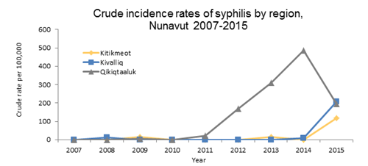
Nunavut Sexual Health Statistics
Government of Nunavut Population Health Information Unit 2015

Slide 10
Nunavut Sexual Health Statistics
Most people support healthy sexuality education!
  More than 8/10 mums and 9/10 adults
22/25 communities have condom dispensers up in their communities!
  15/25 have more than one condom dispenser up (Sanikiluaq and Igloolik have 6 and Baker Lake has 8!)
Nunavut Baseline LQAS Survey 2016, Sexual Health Program Records

Slide 11
What are the most important sexual health issues in Nunavut? CHRs said:
STIs – especially syphilis
Pregnancy – especially teen and unplanned
Child sexual abuse
Multiple partners
Sexual violence – rape, unwanted touching
Sex for money, housing, food, alcohol, or drugs
Parenting
Lack of sexual health education
Fatherhood – men aren’t sure how to be good Dads

Slide 12
What is sexual health?
CHRs said:
  Family planning/ birth control
  Education
  Communication
  Confidence/ self-esteem
  Decision making
  Birth to death/ starts from a young age
  Respect – self and others
  Body parts
  Feelings
  Trust
  Knowledge
  Values
  Who you’re attracted to
  Knowing your body
  Parenting

Slide 13
What is sexual health?
Values – what is important to us
Communication – how we talk to others
Relationships
Body Image and Self-Esteem – how we feel about ourselves
Sexual Health
Anatomy and Physiology – body parts
Physical Expression – sex
Sexual orientation, gender roles, identity
Decision Making

Slide 14
Definition: Sex
Categories that people are assigned at birth based on body parts (male, female)
Sexual activity/ intercourse

Slide 15
Definition: Sexuality/ Sexual Health
How we feel about ourselves (self-esteem)
How we think we should behave as males or females (gender expression)
Who we love (sexual orientation)
How we think about sex – values, attitudes, desires
Overall well-being – not just STIs and unplanned pregnancy!

Slide 16
In other words…
Sex is an act or a body part
Sexuality and sexual health are about being human and general well-being.
We teach sexuality education and sexual health education!

Slide 17
Why do we need to start talking about sexuality when children are young?
Because sexuality is about communication, relationships, feelings, and self-esteem.
When we talk about communication, relationships, feelings, and self-esteem at a young age, children learn how to behave as adults.

Slide 18
Thoughts-Feelings-Behaviour Triangle
Thoughts
Feelings
Behaviours

Slide 19
Thoughts-Feelings-Behaviour Triangle
I’m ugly and stupid.
No one will ever love me. I don’t deserve a good relationship.
I’ll stay in this relationship, even though he/ she hurts me and won’t agree to use a condom, because it’s what I deserve and the best I can get.

Slide 20
Thoughts-Feelings-Behaviour Triangle
Boys are strong. Strength means not crying, and never showing weakness.
I can’t cry, I can’t be vulnerable, but I’m hurting.
Drinking to numb pain and hurt.
Violence, anger, frustration.

Slide 21
Thoughts-Feelings-Behaviour Triangle
Sex is dirty and something I’m not supposed to do. The words are shameful and embarrassing.
I’m ashamed of the way I feel. I feel like I can’t talk to anyone about this.
I can’t ask my parents for advice. I can’t talk to my partner about using a condom. I can’t ask a nurse about getting an STI test.

Slide 22
Changing the thoughts
What can CHRs and other health educators do?
Talk about the “extras” – self-esteem, body image, communication, relationships, feelings.
From a young age, tell children they are good and smart and deserve good things.
Talk about “sexual health” in all sorts of places – not just sexual health class.
Notes:
Is this a role for CHRs?

Slide 23
Thoughts-Feelings-Behaviour Triangle
I’m smart. I deserve good things. My parent/ teacher/ neighbour told me so.
I’m proud of who I am. I’m confident that I can keep myself safe. I want to BE someone!
I’m going to ask my partner to use a condom. I’m going to use birth control.

Slide 24
Talking to our children about sexual health can help them:
  Be safe
  Be happy
  Be healthy
  Have good relationships
  Feel good about their bodies
  Have children when they’re ready
  Wait until they are ready to have sex
Notes:
Doesn’t make them more likely to have sex.
If they are not learning from trusted adults, they are learning from TV, movies, music, and their friends. Often, the information they get from those sources is wrong. If we want them to have the right information, we need to talk to them.

Slide 25
Sexuality Values
What we (personally) consider to be good or bad, right or wrong
Every person has different values
Values are often shared in families

Slide 26
Role of Sexuality Educators
Provide information that is factual, up to date, and objective
Help participants understand their own values and beliefs
Provide an opportunity to develop skills
Build confidence
It’s best not to share our own values – because we don’t want participants to feel bad if our values are different from theirs

Slide 27
What are Inuit values and practices around sexuality (past and present)? CHRs said:
  Multiple partners sometimes – for building a family or for survival
  Respect for yourself, respect for others
  Don’t jump to conclusions – learn more
  No discrimination
  Don’t confuse respect with knowledge
  Have children when you can provide for a family
  Have children when you’re ready to be a teacher
  Gender roles start very young – hunting/ sewing
  Arranged marriages – what is good for the community?

Slide 28
Sexuality Values
Please watch the video “Two Soft Things, Two Hard Things” (available through your local CHR, or by contacting sexualhealth@gov.nu.ca)
As you’re watching the video, think about your personal values about sexuality
  What do you think about lesbian, gay, and transgender people?
  Do you think there are lesbian, gay, or transgender people in your community?
  How do you think it might feel to be lesbian, gay, or transgender in Nunavut?
  What can you say or do to show in your community and as you are teaching to respect lesbian, gay, or transgender people?
Notes:
How do you think it might feel?
Lonely
Scary
Sad
Want to hurt themselves
What can you do to show LGBTQ people that you respect them?
Treat everyone with respect
Not use words like “fag”, “dyke” or other mean words
Use the word “partner” when talking about boyfriends/ girlfriends – don’t assume that boys have girlfriends and girls have boyfriends

Slide 29
Children and youth need different information at different ages

Slide 30
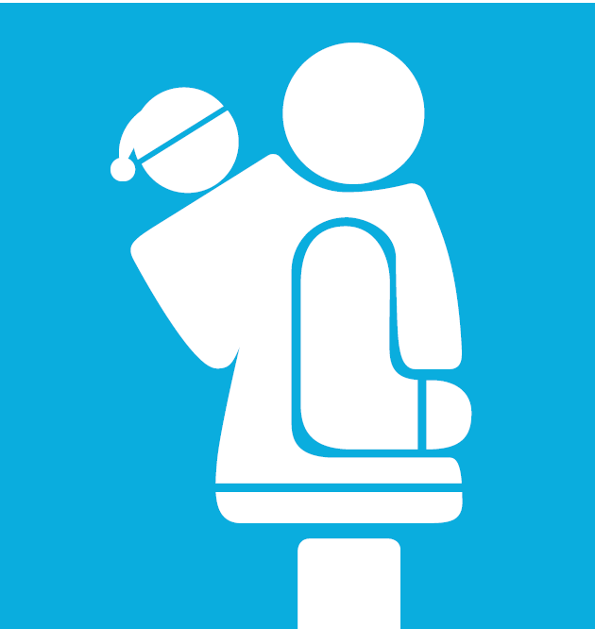
Ages 0-2
Name body parts
  penis, vagina, bum, breasts

Slide 31
Ages 2-7
Public and private parts and activities.
Who can touch them, when. Be specific!
Safe and unsafe touch. Tell them to tell you, that you won’t be mad, and it’s not their fault.
Recognize and name feelings.
Answer questions simply.
Notes:
Be specific.
It’s ok if mummy or daddy helps you wipe after you go to the bathroom.
It’s ok if the nurse or doctor needs to check your private parts, as long as mummy or daddy are there.
It’s ok if someone is helping you get dressed.
If someone asks you to touch their private parts, that’s not ok.
If you’re sleeping at a friend’s house, and someone wants to get into bed with you, that’s not ok.

Slide 32
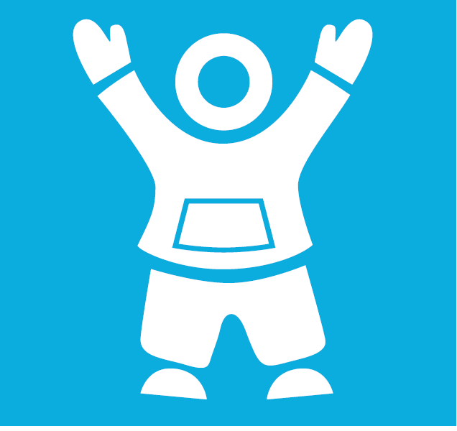
Ages 7-12
How babies are made
Family values and expectations
Build self-esteem
Puberty (age 8-9)
Sexually transmitted infections and birth control (ages 10-12)

Slide 33
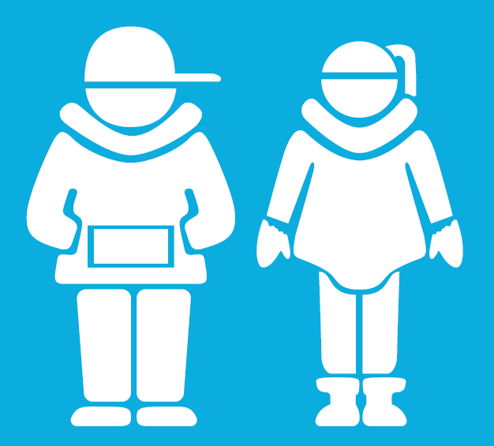
Ages 13-18
Start conversations
More detail - STIs and birth control
Healthy and unhealthy relationships
Decision making – be specific!
Build self-esteem
Promote safety
Build skills, including communication

Slide 34
Our role as sexuality educators
Build our participants’
Knowledge
Skills
Confidence
How can we do this?

Slide 35
Best Ways to Teach
CHRs said:
Find out what they already know
Make them feel good about themselves – recognize success!
Make it relevant to their life
Focus on good things – not just fear
Humour – get the giggles out
Drama/ Role Play
Telling stories
Yell out words to get comfortable saying them
Arts and crafts
Songs
Radio and TV script writing
Videos
Activities and games
Debates
Expert groups – have them teach themselves!
Storytelling
Hands-on
Pictures
Guest speakers
Field trips
Question box
Ask questions to check participant’s understanding

Slide 36
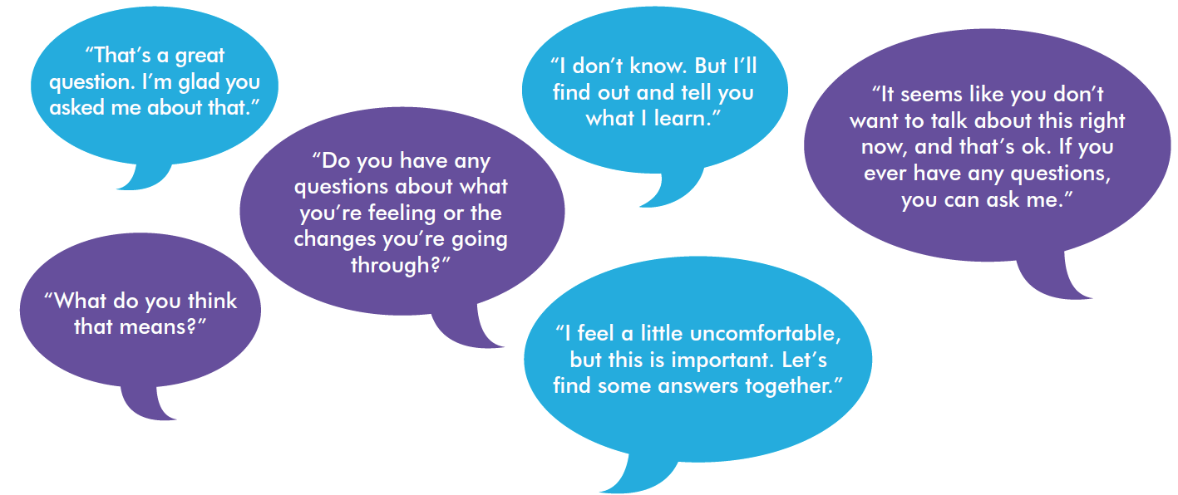
Tips for educators teaching sexual health
Be honest, open, and welcoming
Keep your sense of humour
Don’t worry if the conversation isn’t perfect
Use TV shows, music, movies, the news, and real life to start a conversation.

Slide 37
“People won’t remember what you said or what you did. They will remember how you made them feel.”

Slide 38
Trauma-Informed Teaching
Sexual health education may feel unsafe for individuals who have experienced sexual violence.
Suggested Practices:
  Create a safe space for participants to leave the room or not participate if necessary
  Ask a nurse or mental health consultant to attend your session and provide support
  Recognize that sexual activity and condom use are not always choices. There are alternative harm reduction strategies for these situations, including regular STI testing.
  Talk about respect and confidentiality at the beginning of each session.
  See “Child Sexual Abuse - Information for Educators” for more information on reacting to disclosures of abuse (www.irespectmyself.ca)

Slide 39
Consider…
Asking a respected Elder to come in and speak about the topic to share traditional knowledge and values.
Meet with the Elder in advance to discuss the topic and ensure appropriate, inclusive, and respectful sharing of knowledge. Consider whether there is any potential for hurt or harm in the information being shared.
After the Elder leaves, have a discussion with your group about similarities and differences between traditional and modern knowledge. Be prepared to answer questions with objective, factual, and up-to-date information.

Slide 40
Useful Tools for Teaching Sexual Health
Group Agreement/ Ground Rules
Parking Lot
Icebreaker Activities
Question Box
Sexual Health Toolkit
www.irespectmyself.ca

Slide 41
Tool: Group Agreement/ Ground Rules
All questions are ok, at any time.
If someone tells a personal story inside this room, it stays in this room.
No judgement – we all have our personal values and beliefs.
No putting anyone down.

Slide 42
Tool: Parking Lot
Use the parking lot when you have an off-topic question or comment
It helps you stay on track
Write the off-topic question/ comment on a piece of flip-chart paper or on the board – so that you remember to answer it later

Slide 43
Icebreaker Activities
These activities are used at the beginning of a presentation to “break the ice”, introduce the topic gently, and increase comfort.
Icebreaker activity suggestions can be found here: http://www.iwtc.org/ideas/10_games.pdf

Slide 44
Tool: Question Box
Provide an opportunity for participants to ask questions anonymously.
You don’t have to know the answer to everything - Don’t answer the questions on the spot!
Go back to the office, prepare your responses, and follow up with the group to share the answers.
Answer the question clearly, objectively, and factually.
Notes:
Ask everyone to submit a question

Slide 45
Tool: Question Box
There are four types of questions
  Request for information
  “Am I normal?”
  Values based/ permission seeking
  Shock questions (are often requests for information)

Slide 46
Tool: Question Box
You don’t have to answer questions that:
  Are not about sexuality
  Are about you, your personal life, or your sexuality
  Are beyond the grade level
  Are about animals
  That you can’t read

Slide 47
Tool: Sexual Health Toolkit
Anatomically correct models (penis and vagina) – practice putting on condoms!
Drunk goggles – for students to see how hard it is to put on a condom while drunk
Stuffed “critters” – for an activity to learn about different types of STIs
Pamphlets
CDs, DVDs
2 USBs – one with an activity guide, videos, and video player; one where Rosie Kagak demonstrates how to use the toolkit
All CHRs have a sexual health toolkit; some schools do

Slide 48
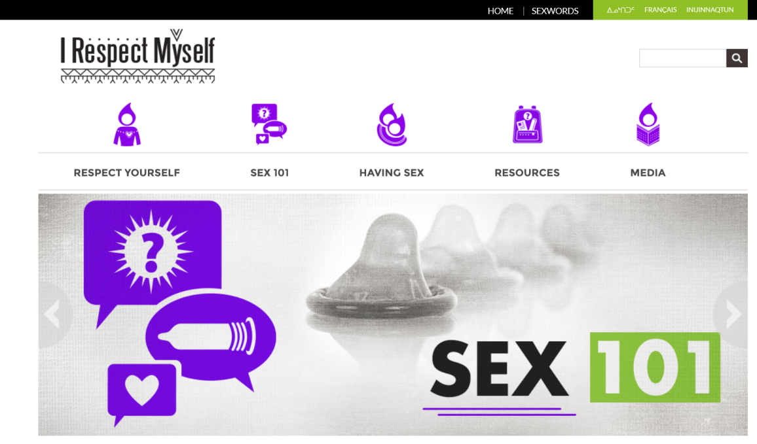
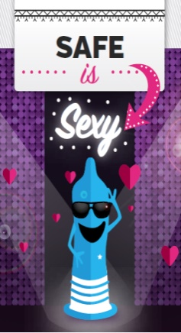
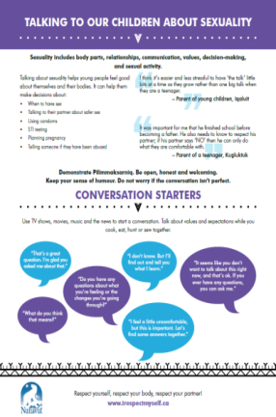
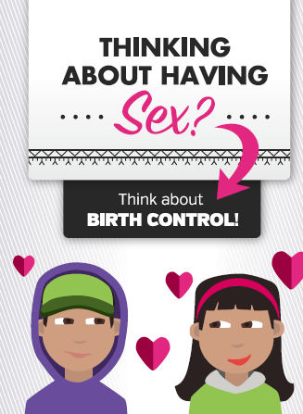



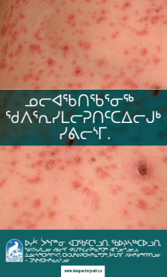
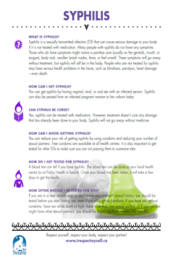
Tool: www.irespectmyself.ca
Information
Resources
Lesson plans

Slide 49
Resources
Further education
  Alberta Society for the Promotion of Sexual Health: Online Workshop for Sexual Health Educators http://www.aspsh.ca/#!online-workshops/c191s
Putting sexuality back into Comprehensive Sexuality Education: Making the case for a rights-based, sex-positive approach
Activities for teaching sexual health
  Games for teaching adolescent reproductive health http://www.iwtc.org/ideas/10_games.pdf
  Embodied Sex Ed Games http://www.fluidexchange.org/uploads/1/9/1/4/19148883/embodied_games_-_karenbkchan.pdf

